Slide 1
John H. Prescott Marine Mammal Rescue Assistance Grant Program
FY2024 Post-Award Management

Slide 2
Introductions
Artie Wong
Program Manager, Pre-award
Mackenzie Griffin
Post-award
Steve Manley
Assisting Artie and Mackenzie with Prescott
Ryan Elican
Grants Management Division (GMD)
Grants Specialist
Notes:
New grants specialist, Ryan, just joined this year. Michele (former grants specialist), Artie, and I are working on introducing him to Prescott and getting him up to speed.

Slide 3
Prescott Timeline
Application
Early to mid-October
Grant is awarded
Before the end of September in the same fiscal year
Award period
Can start immediately or may be delayed a few months
Only 1 year
Expiration date
Can be extended with a No Cost Extension (NCE)
Award closed
120 days after expiration
Submit final financial and progress reports during this 120 days
Can get an extension to closeout (+90 days)
Notes:
Currently, those with 2023 grants are working in the beginning of your award period, 1st progress report will be due in the coming months. However, with eRA having their complications, we are flexible with any delays. Just please be sure to communicate any issues you are experiencing.

Slide 4
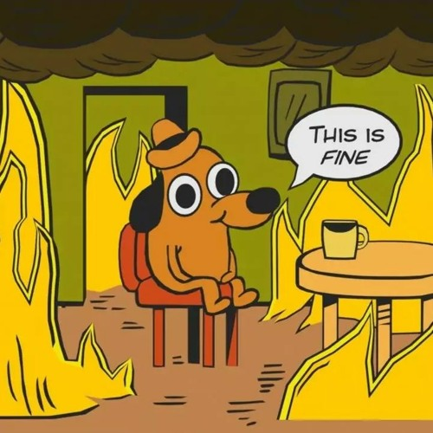
electronic Research Administration (eRA)
New system used by NOAA to manage the life-cycle of an award
Formal actions should be conducted in eRA…
Progress reports, revision requests, award closeout, etc.
Notes:
We’d like to thank you all for being patient with this new grant system transition. Unfortunately, we had no say in this change and are internally trying to navigate it as well with very little guidance. GEMS is a DOC program that decided to swith to the new eRA system. eRA has been managing grants for over 30 years, used by many other federal agencies. However, we are aware this system is not efficient nor beneficial for our program at this time. We hope this changes soon and grants management will improve with this system.
In October 2023 all active grants were migrated from GOL to eRA. There are many hiccups with the system so we understand any issues or questions you may have. On our end, we are doing our best to be flexible, especially with report deadlines. Please just be sure to remain in communication if you’re having issues.

Slide 5
eRA vs. GOL terms
 | GOL | eRA
Program role | PI/PD | Principle Investigator (PI)
Administrative roles | Authorized representative | Signing Official (SO)
 | Business/Finance | Financial Status Reporter (FSR)
 | Recipient Administrator | Administrative Official (AO)
 |  | Account Administrator (AA)
Post-award actions | Award Action Requests | Revision Requests
Notes:
There was some change in terminology but means the same functions. For eRA, you need 2 separate accounts for a programmatic role and administrative role. Even if the same person is both, you need 2 separate log ins/accounts…

Slide 6
Roles | Performance Progress Report (PPR) | Research PPR (RPPR) | Federal Financial Report (FFR) | Revision Requests
Principle Investigator (PI) | View, modify, and submit | Initiates, completes, and forwards to SO | Initiates, completes, and forwards to SO
Signing Official (SO) | View, modify, and submit | View, modify, and submit | View, modify, and submit* | Submits
Financial Status Reporter (FSR) |  |  | View, modify, and submit
Administrative Official (AO) |  | View | View, modify, and submit*
Account Administrator (AA) |  |  | View, modify, and submit*
*must be assigned FSR role
Notes:
Although you need 2 separate accounts for admin vs programmatic role, you can have 1 account for several admin roles. You can add the “FSR role” to the SO, AO, and AA so they can modify and submit financial documents. Overall, at minimum, there should be a PI and Signing Official role assigned

Slide 7
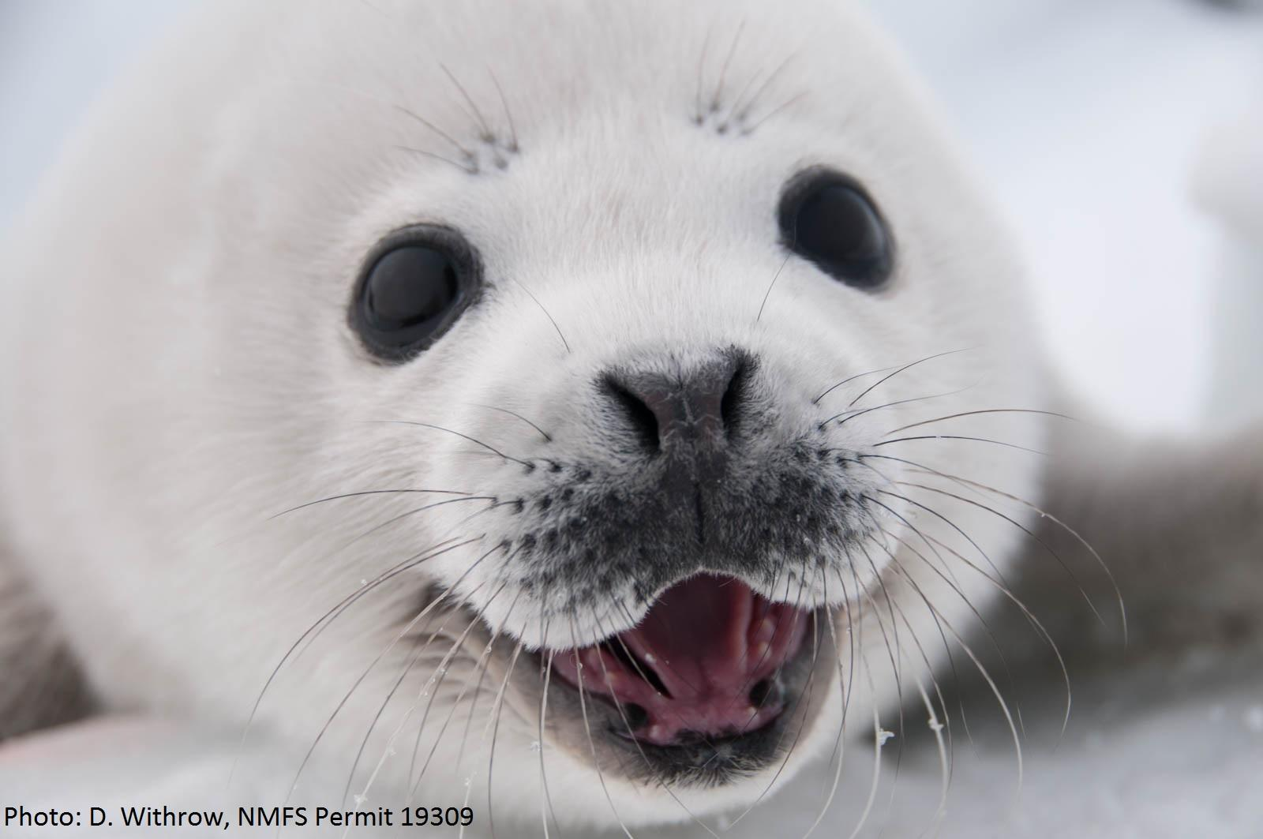
First step
Confirm correct PI
Very important to know who the point of contact is for the award
Ensures notifications reach the correct person
PI info was transferred from GOL*
Notes:
Previous issue with Pis being changed for thousands of grants but should be resolved
If the PI is not correct or no one is designated, “DOC PD/PI Name, Not Available’ please let us know
GMS updates/corrects the PI by using “Replace PI” option NOT “Edit PI”
Even if PI is the same as SO, needs 2 accounts
SO- administrative role
PI- programmatic role
eRA roles: chrome-extension://efaidnbmnnnibpcajpcglclefindmkaj/https://www.era.nih.gov/files/eRA_Commons_Roles.pdf

Slide 8
Example Prescott Timeline
Award starts
August 1, 2024
1st PPR
March 1, 2025; Covers Aug to end of Jan
Award ends
July 31, 2025
2nd PPR
August 30, 2025; Covers Feb to end of Jul
Final PPR
November 28, 2025; Covers the whole project period
Notes:
This is just an example of a 1 year Prescott award timeline. PPRs and RPPRS are due 30 days after every 6 month period

Slide 9
PPR
Technical Monitor
PI
SO
and
Accepted
both can submit
Program Officer
Research PPR
Returned for Revisions
submits
PI
SO
initiates
Notes:
Here is the flow of your progress report once it’s submitting. For PPRs, the Signing Officials and Pis can submit reports in Terms Tracking. For RPPRs, the PI can initiate the RPPR but the Signing Official submits.
Both types of reports are reviewed by Program staff and regional technical monitors. Tech monitors are regional or HQ staff that are involved in stranding/entanglement programs. We may ask for revisions to the reports to clarify for the record.

Slide 10
Progress Reports (PPR)
There is no official form but there are requirements
Grant number
Federal, match, and total amount of grant
Project title
Grantee (named on award agreement)
Award period
Dates covered by the report
Summary of progress to date- include descriptions of tasks scheduled for the period and accomplished during the period
Explanation of problems and differences between scheduled and accomplished work (i.e. natural disasters, low/high projected strandings)
Notes:
Basically the report should be keeping us up to date on what you are doing. If you changed anything or have encountered any problems, do not hesitate to include it!
https://www.fisheries.noaa.gov/national/funding-and-financial-services/prescott-grant-reporting-requirements-award-recipients#progress-reports

Slide 11
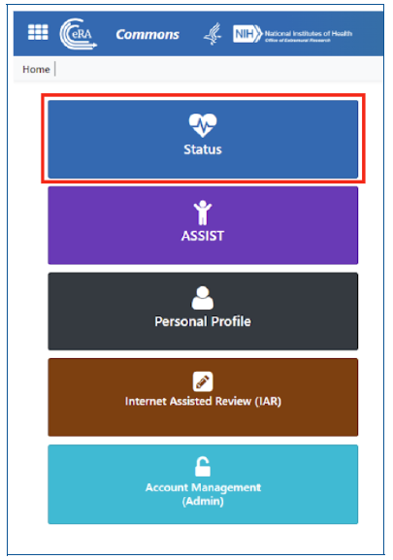
Submitting a PPR
Log in and select the Status Module
SO and PI have different views after logging in
Notes:
PI and SO view after signing in

Slide 12
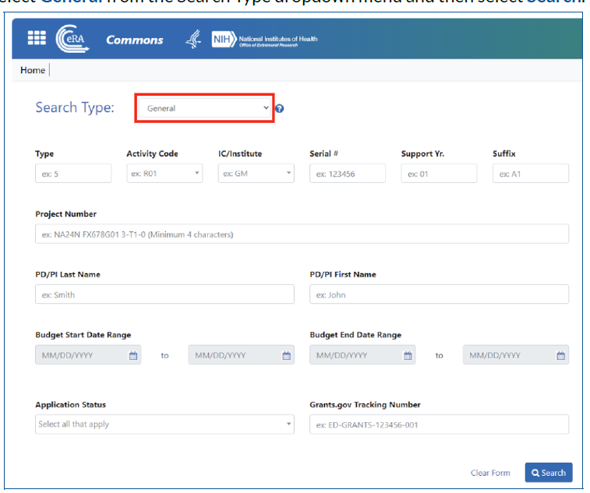
Submitting a PPR
SO View
Select General as Search Type
Notes:
SO View

Slide 13
Submitting a PPR
SO View
Find the award, click the 3 dots, then select View Terms Tracking
Notes:
SO View

Slide 14
Submitting a PPR
PI View
Select List of Applications/Awards
Notes:
PI View

Slide 15
Submitting a PPR
PI View
Select the + button to expand the award
From Available Actions, select View Terms Tracking
Notes:
PI View

Slide 16
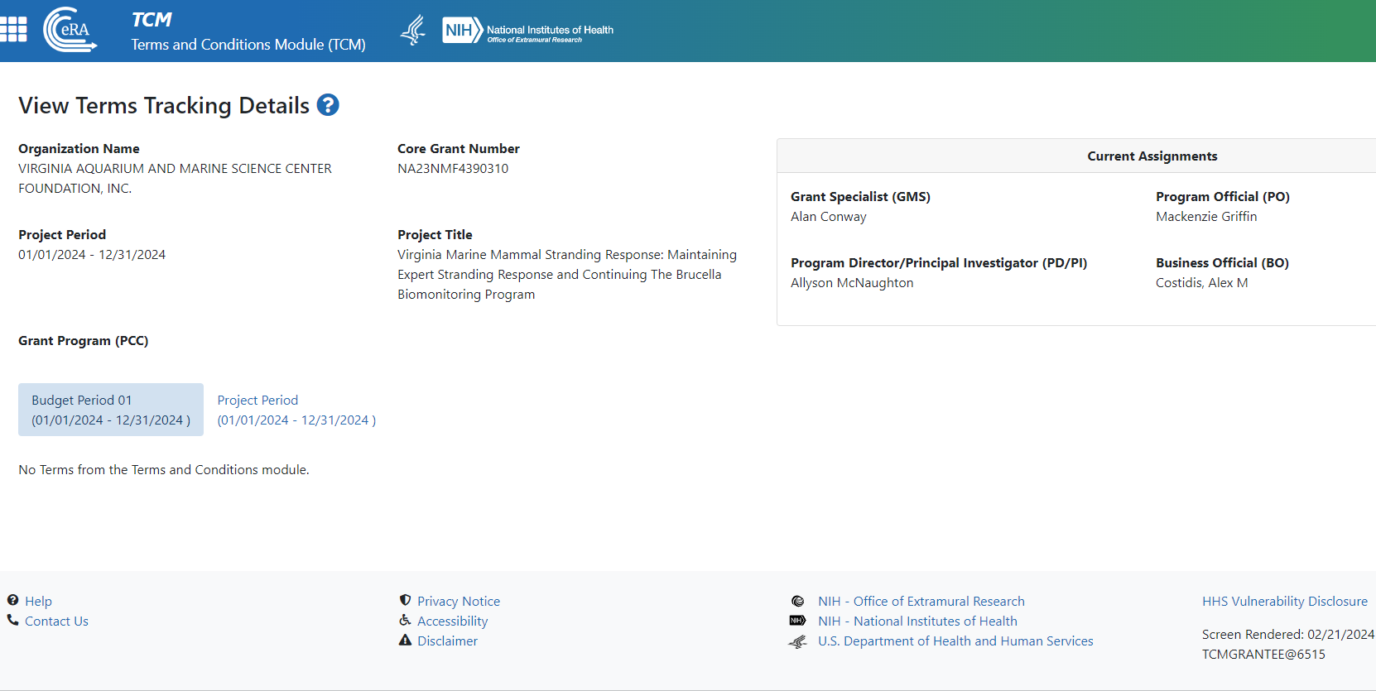
Submitting a PPR
After selecting View Terms Tracking, SO and PI view will be the same
Notes:
SO and PI View

Slide 17
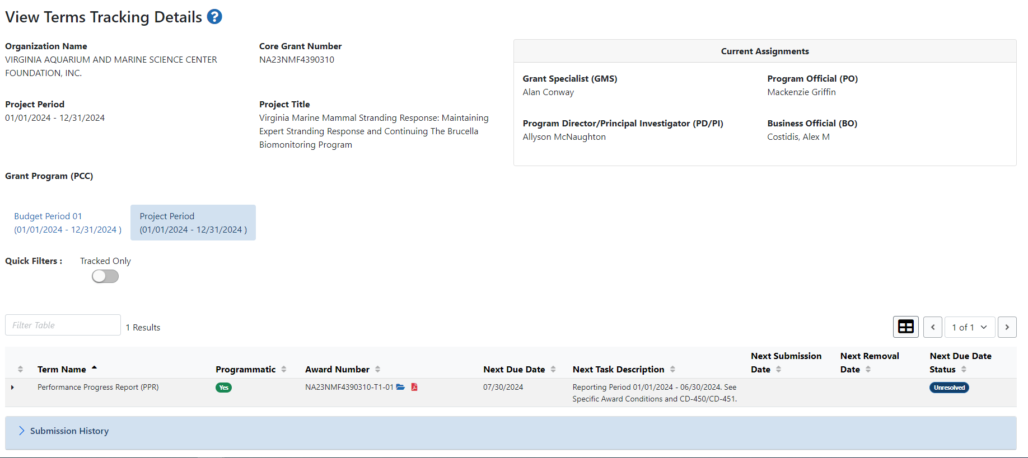
Submitting a PPR
Be sure to select Project Period then the small arrow to the left
Notes:
SO and PI View

Slide 18
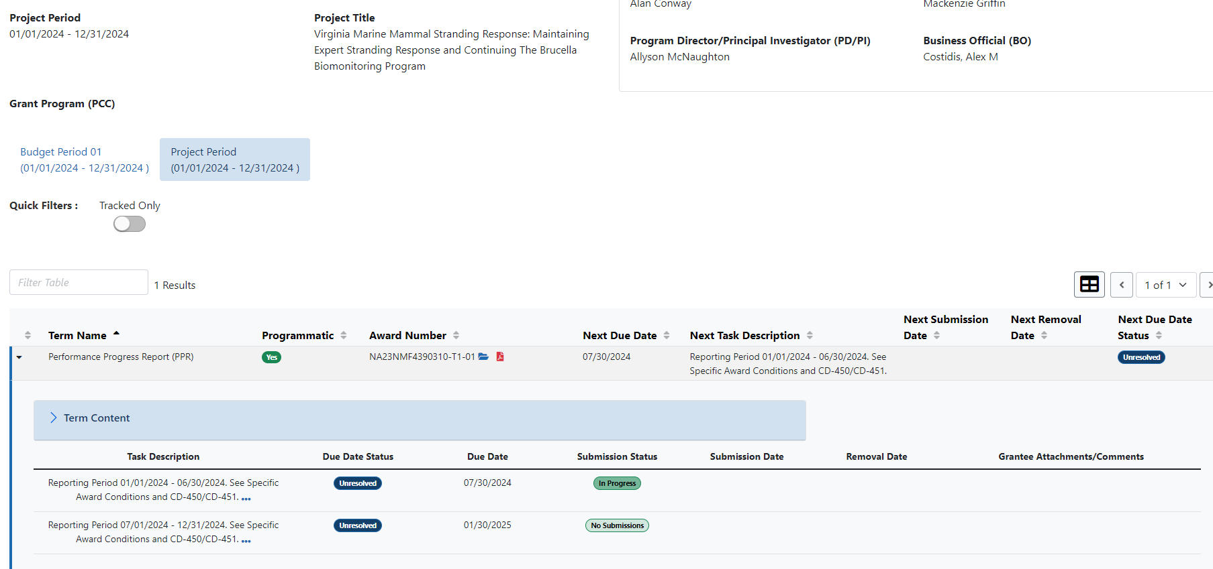
Submitting a PPR
Be sure to select Project Period then the small arrow to the left
Notes:
SO and PI View

Slide 19
Submitting a PPR
Click the 3 dots next to the report you want to complete, then Prepare Documentation
Notes:
SO and PI View

Slide 20
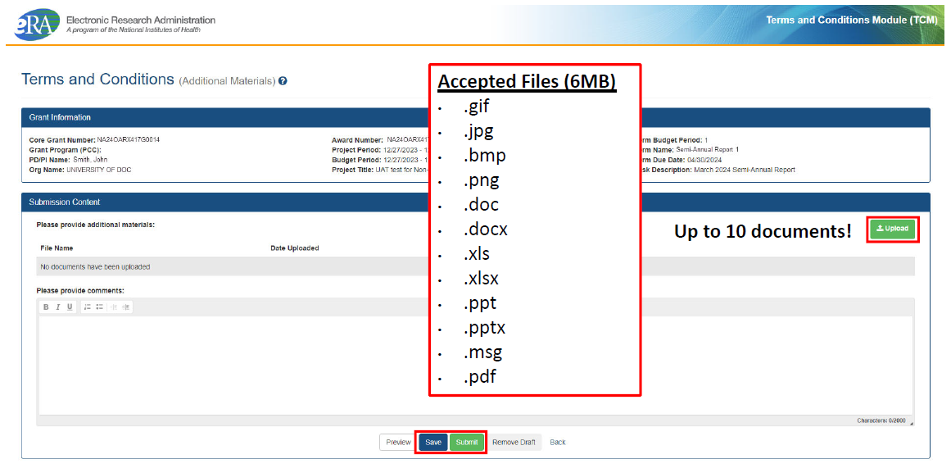
Notes:
SO and PI View. Unfortunatly, there is a limited upload size. GMD is aware and they are working on fixing this. In the meantime, feel free to upload what you can in eRA. Then email me the full report. Thank you!

Slide 21
Submitted!
Notes:
PO and SI View

Slide 22
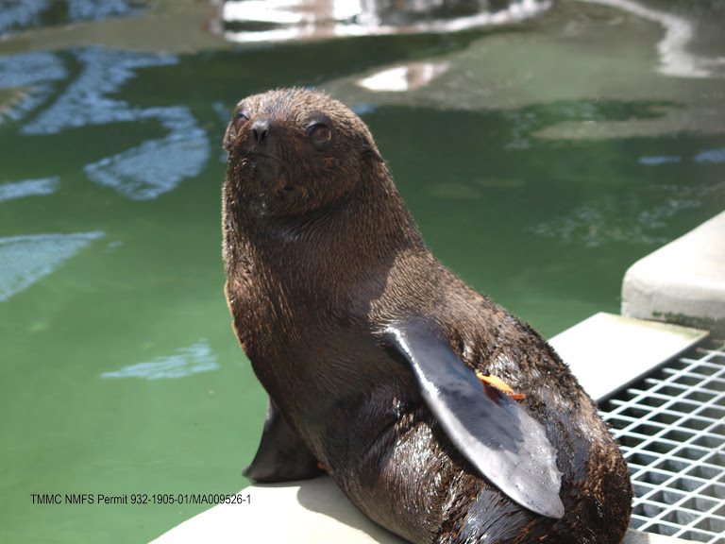
Research Progress Reports (RPPR)
Research grants (category A1) have a form auto-generated by the system
Fill out as many boxes as you can
Can attach additional documents or pictures if necessary
PIs can initiate and edit but only SO can submit

Slide 23
RPPR
Notes:
After searching for the award, there should be an available button to complete your report

Slide 24
RPPR
Notes:
PI View

Slide 25
RPPR
PI View
Notes:
PI View

Slide 26
RPPR
PI View
Notes:
PI View- has options to edit and “Route to Next Reviewer” which would be the Signing Official

Slide 27
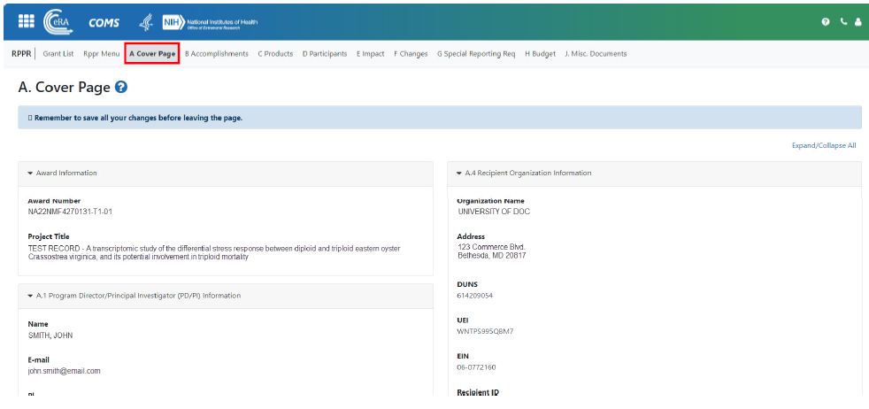
RPPR
Notes:
The top banner has all the sections you need to complete

Slide 28
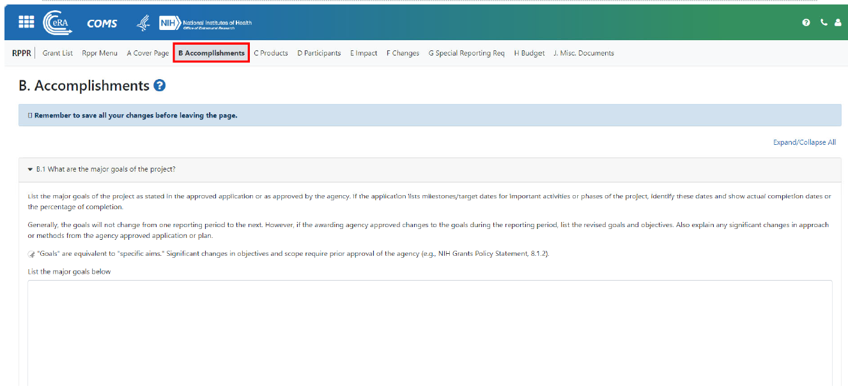
Be sure to fill out the questions in each field. Feel free to attach any additional pictures or documents within the report

Slide 29
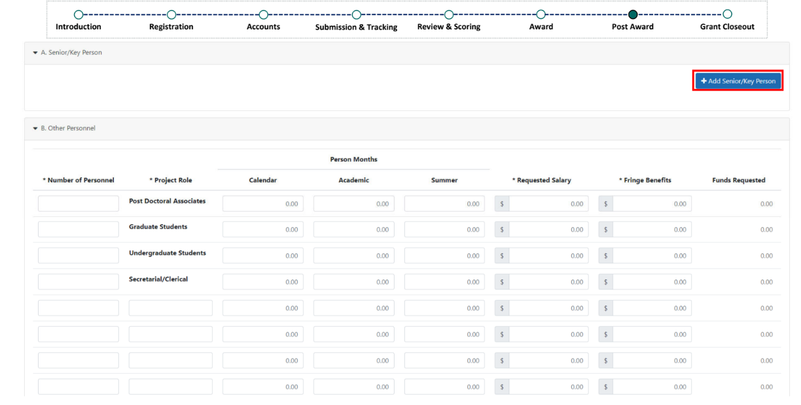
Notes:
We have been notified that the budget portion for the RPPR is unclear. Please note that we as a program don’t require budgets in semi-annual reports but eRA has a mandatory section for you to fill out. For now, please complete the budget section based on how you split finances in your approved proposal. For example, if this is the 1st semi-annual report of a 1-year award, enter half of the yearly salary for your PI. You can
Please note that we are working on our end to resolve budget questions- for the time being, fill out to the best of your ability or email me your report directly

Slide 30
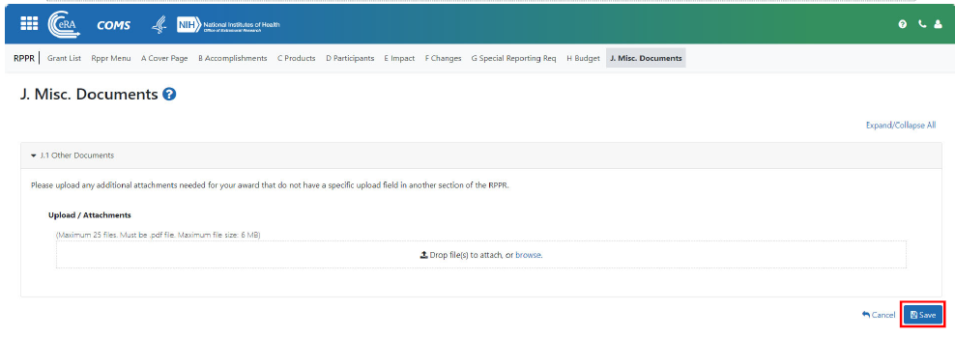
Notes:
Now an easier way to upload additional files and photos. Please be sure to still fill out the questions in the report and use uploads if you have additional documents.

Slide 31
PI Routes to Next Reviewer
SO Submits
Notes:
Shows the different actions a PI and SO will have when submitting the RPPR.
PI will route to SO
SO will then log in to search for the award then submit

Slide 32
Progress Reports
Please let us know if you expect delays in submissions or are having issues with eRA
Be sure to contact the Help Desk and in the meantime email me (mackenzie.griffin@noaa.gov) your reports directly

Slide 33
Financial Reports
Submitted directly to NOAA Grants Management Division (GMD)
Program office can and may be asked to review as well
Best to draw down funds as you go (quarterly or monthly even)
Do not wait until the end of your award to draw everything down at once
Register for Automated Standard Application for Payments (ASAP) if you aren’t already
If you need to register, reach out to Artie and Mackenzie
Notes:
After our 1st post award seminar, many of you noted financial report issues. We talked with GMD and they are currently aware as well. For now, please hold off on submitting these financial reports. Disregard delinquent financial report alerts until we are provided further guidance. Thank you!

Slide 34
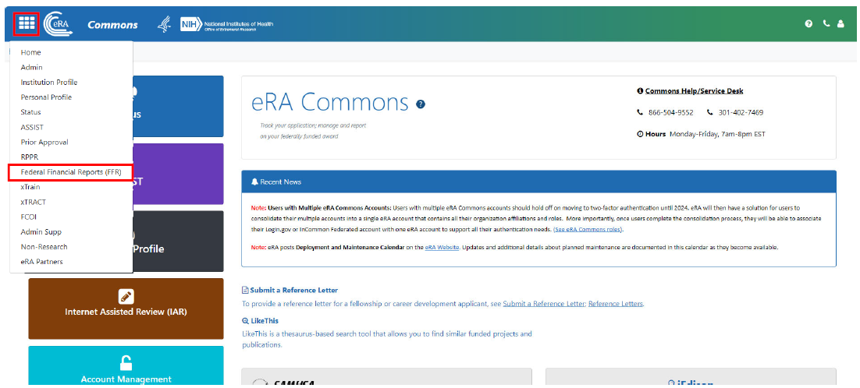
Financial Reports
Submitting the financial reports and payment requests
Must have the Financial Status Reporter (FSR) role
FSR role can be added to the signing official (SO), admin official (AO), and account admin (AA)
More detailed instructions found in eRA 2 pdf
Notes:
After our 1st post award seminar, many of you noted financial report issues. We talked with GMD and they are currently aware as well. For now, please hold off on submitting these financial reports. Disregard delinquent financial report alerts until we are provided further guidance. Thank you!
This slide shows where to submit the FFRs once issues are resolved.

Slide 35
Prescott Timeline
Award starts
August 1, 2024
1st PPR
March 1, 2025; Covers Aug to end of Jan
Award ends
July 31, 2025
2nd PPR
August 30, 2025; Covers Feb to end of Jul
Final PPR
November 28, 2025; Covers the whole project period
Notes:
Final PPRs and RPPRs are due 120 days after the award period ends
Financial progress report also due
All draw-down of funds and requests for reimbursements must be completed prior to submission of this report

Slide 36
Grants Closeout
Log in and select the Status Module
SO and PI have different views after logging in
SO can access Final progress report, only role that can submit
PI completes the Final progress report
FSR completes and submits Financial reports
SO, AO, and AA may have this role added

Slide 37
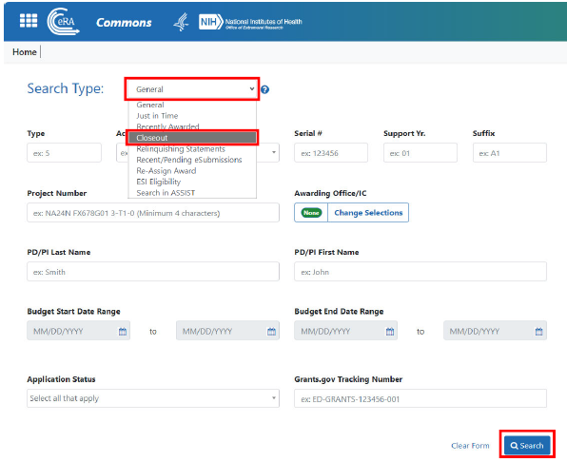
Grants Closeout
SO View
Select Closeout as Search Type

Slide 38
Grants Closeout
SO View
Find the award, click the 3 dots, then select Requires Closeout

Slide 39
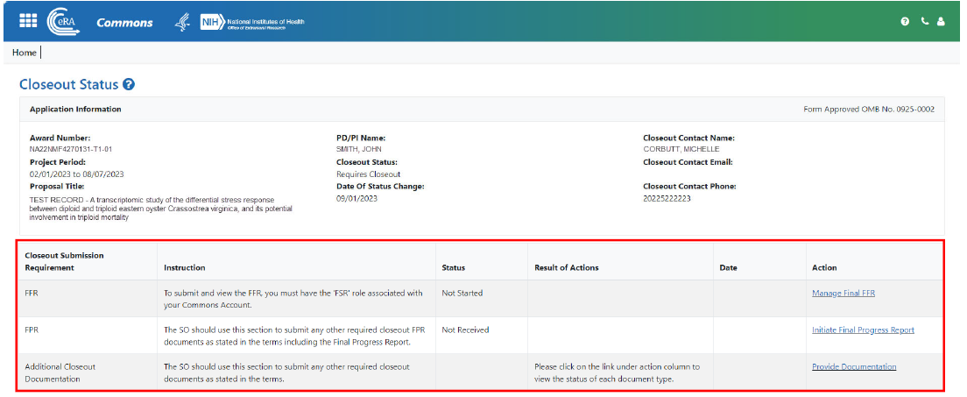
Grants Closeout
SO View
Shows the list of Closeout items required

Slide 40
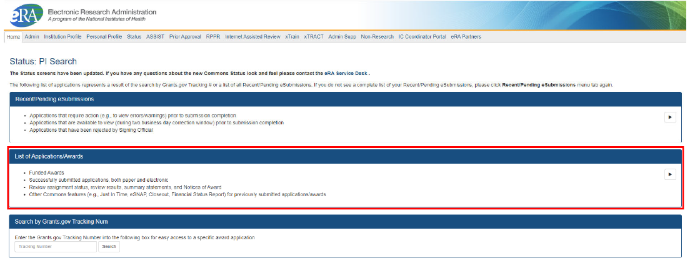
Grants Closeout
PI View
Select List of Applications/Awards

Slide 41
Grants Closeout
PI View
Select the + button to expand the award
From Available Actions, select Requires Closeout

Slide 42
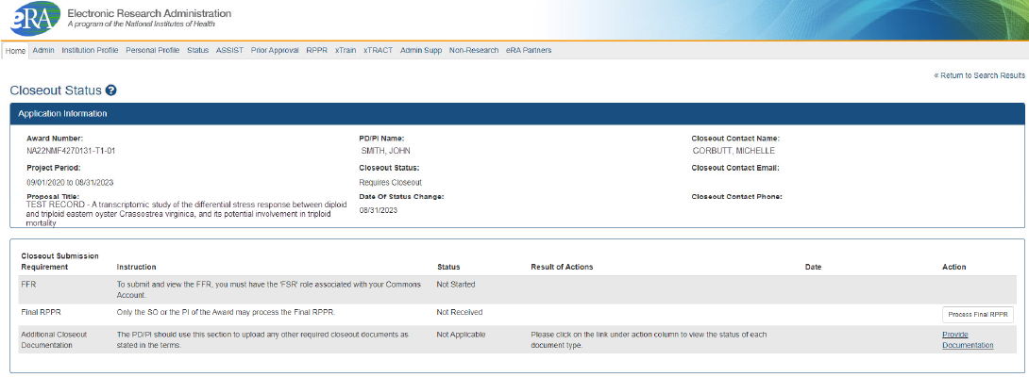
Grants Closeout
PI View
Shows access to the Final progress report

Slide 43
Final Progress Reports
Due 120 days after grant expiration
Similar to semi-annual reports except:
Summarizes accomplishments during the whole grant period
Lists all biological samples collected
Explains how the project results have been or will be disseminated
Includes budget outlining expenditures
Compare projected vs. actual
NMFS ESA/MMPA Permit #779-1633

Slide 44
Revision Requests
Life happens and there may be revisions needed to successfully complete your project
Revision Requests are here to help!
Please let us know as early as possible if you think you may be interested
Common revision requests:
Rebudget
Extension to Closeout
No-Cost Extensions
Notes:
I try to reach out 1 to 2 months before your award ends. Even if you believe you are on track to close, please let me know. Thank you

Slide 45
Budgeting
Funds that are not spent by a recipient are NOT returned to the Prescott Grant Program
Performance of past Prescott awards are considered during new application review
Revision Requests (formerly known as AARs) are available to help you meet or adapt the objectives of your original proposal
E.g. rebudget, Extension to Closeout, and NCEs
Submitted through eRA but please email Mackenzie if you’re having any issues navigating eRA
Notes:
NOTE: Saving money does not save the program any money!! Remaining funds are also a consideration when reviewing future applications.

Slide 46
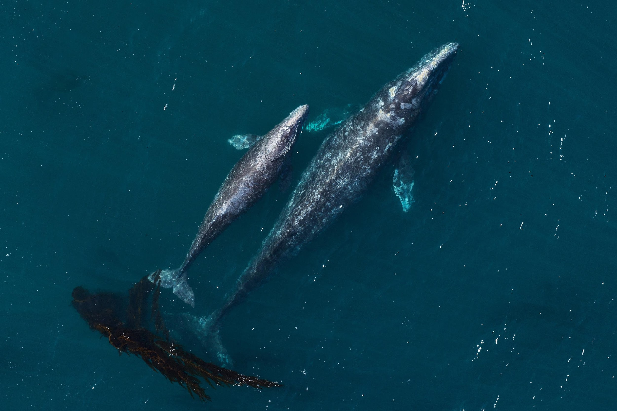
Re-budgeting
Please let us know if you are interested in a rebudget
Note any budget changes within your progress reports
When is formal prior approval needed?
Moving greater than 10% of the total award (federal + match)
Altering indirect costs
Creating or eliminating categories
What is needed for this request?
A justification and updated SF424A
Table showing the budget differences from your original proposal

Slide 47
vs.
Extension to Closeout
NCE
Can request up to 90 days
Can be submitted after award end date
No additional expenses or activities allowed
Can pay off outstanding balances
Automatically approved
Grant is expired/closed
Can request up to 12 months
Must be submitted before award end date
Can continue project objectives, activities, and approved expenses
Requires FPO and GMD approval
Grant is active/open
Notes:
Extension to closeout- costs must have been incurred during the project period

Slide 48
Extension to Closeout
Up to 90 additional days after an award ends to submit all closeout reports
Often used to finalize reports, results of samples, and complete invoices
Must include:
Justification

Slide 49
Prescott Timeline
Award starts
August 1, 2024
Active
Award ends
July 31, 2025
Request an Extension to Closeout
Final PPR
Feb 28, 2025
Expired
November 28, 2025; Covers the whole project period

Slide 50
No Cost Extensions (NCE)
If you cannot meet your objectives by the expiration date, you can get an extension
Includes goals, match, etc.
There is no penalty for NCE
We recommend 6 or 12 month NCEs due to reporting requirements
GMD will typically approve the 1st NCE but 2+ require strong justification
Notes:
Should be keeping an eye on expiration date and remaining funds.
Progress reports will be due every 6 months during extension
Can extend multiple times, with approval, but NO grant can go beyond 5 years.
Can apply for a new grant with old grant under NCE.
No penalty= you are still eligible to apply, can still be awarded another grant while using an NCE

Slide 51
No Cost Extensions (NCE)
Must submit:
Justification (why objectives were not met)
New requested date
Budget of remaining funds and how they will be spent
GMD needs 30 days to process
Less than 10 days GMD may refuse to process
Notes:
Should be keeping an eye on expiration date and remaining funds.
GMD will often not process NCE requests less than 10 days before expiration.

Slide 52
Prescott Timeline
Award starts
August 1, 2024
1st PPR
March 1, 2025; Covers Aug to end of Jan
Request an No Cost Extension (NCE)
Award ends
July 31, 2025
2nd PPR
August 30, 2025; Covers Feb to end of Jul
3rd PPR
4th PPR
Award Ends
July 31, 2026
Final PPR
2027
November 28, 2025; Covers the whole project period

Slide 53
Revision Requests
Only initiated and submitted by Signing Officials (SO) via the Status module

Slide 54
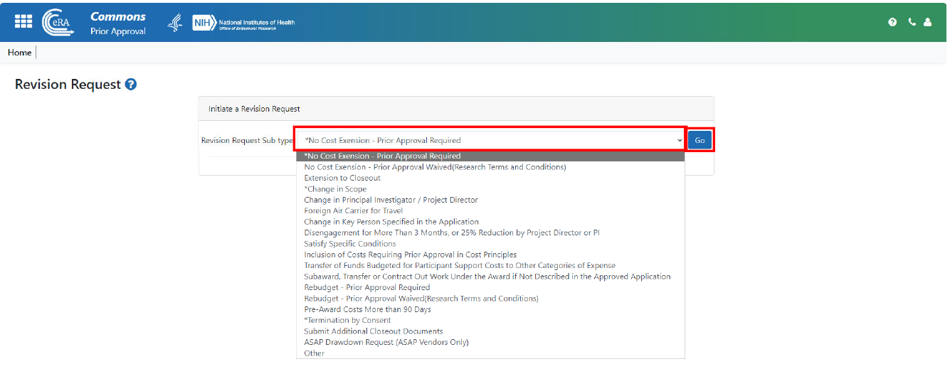

Slide 55
Will need to upload your justification rather than typing directly into eRA

Slide 56
Resources
Artie (arthur.wong@noaa.gov)
Mackenzie (mackenzie.griffin@noaa.gov)
Steve (stephen.manley@noaa.gov)
Google Drive with eRA Resources
Prescott website
GEMS External Resource Page
eRA Help Desk
(866) 504-9552 or (301) 402-7469 Monday - Friday 7 AM to 8 PM EST
Submit a Form
Notes:
We are here to help, if you have any questions do not hesitate to contact us
Helpdesk very responsive, can help reset accounts, etc

Slide 57
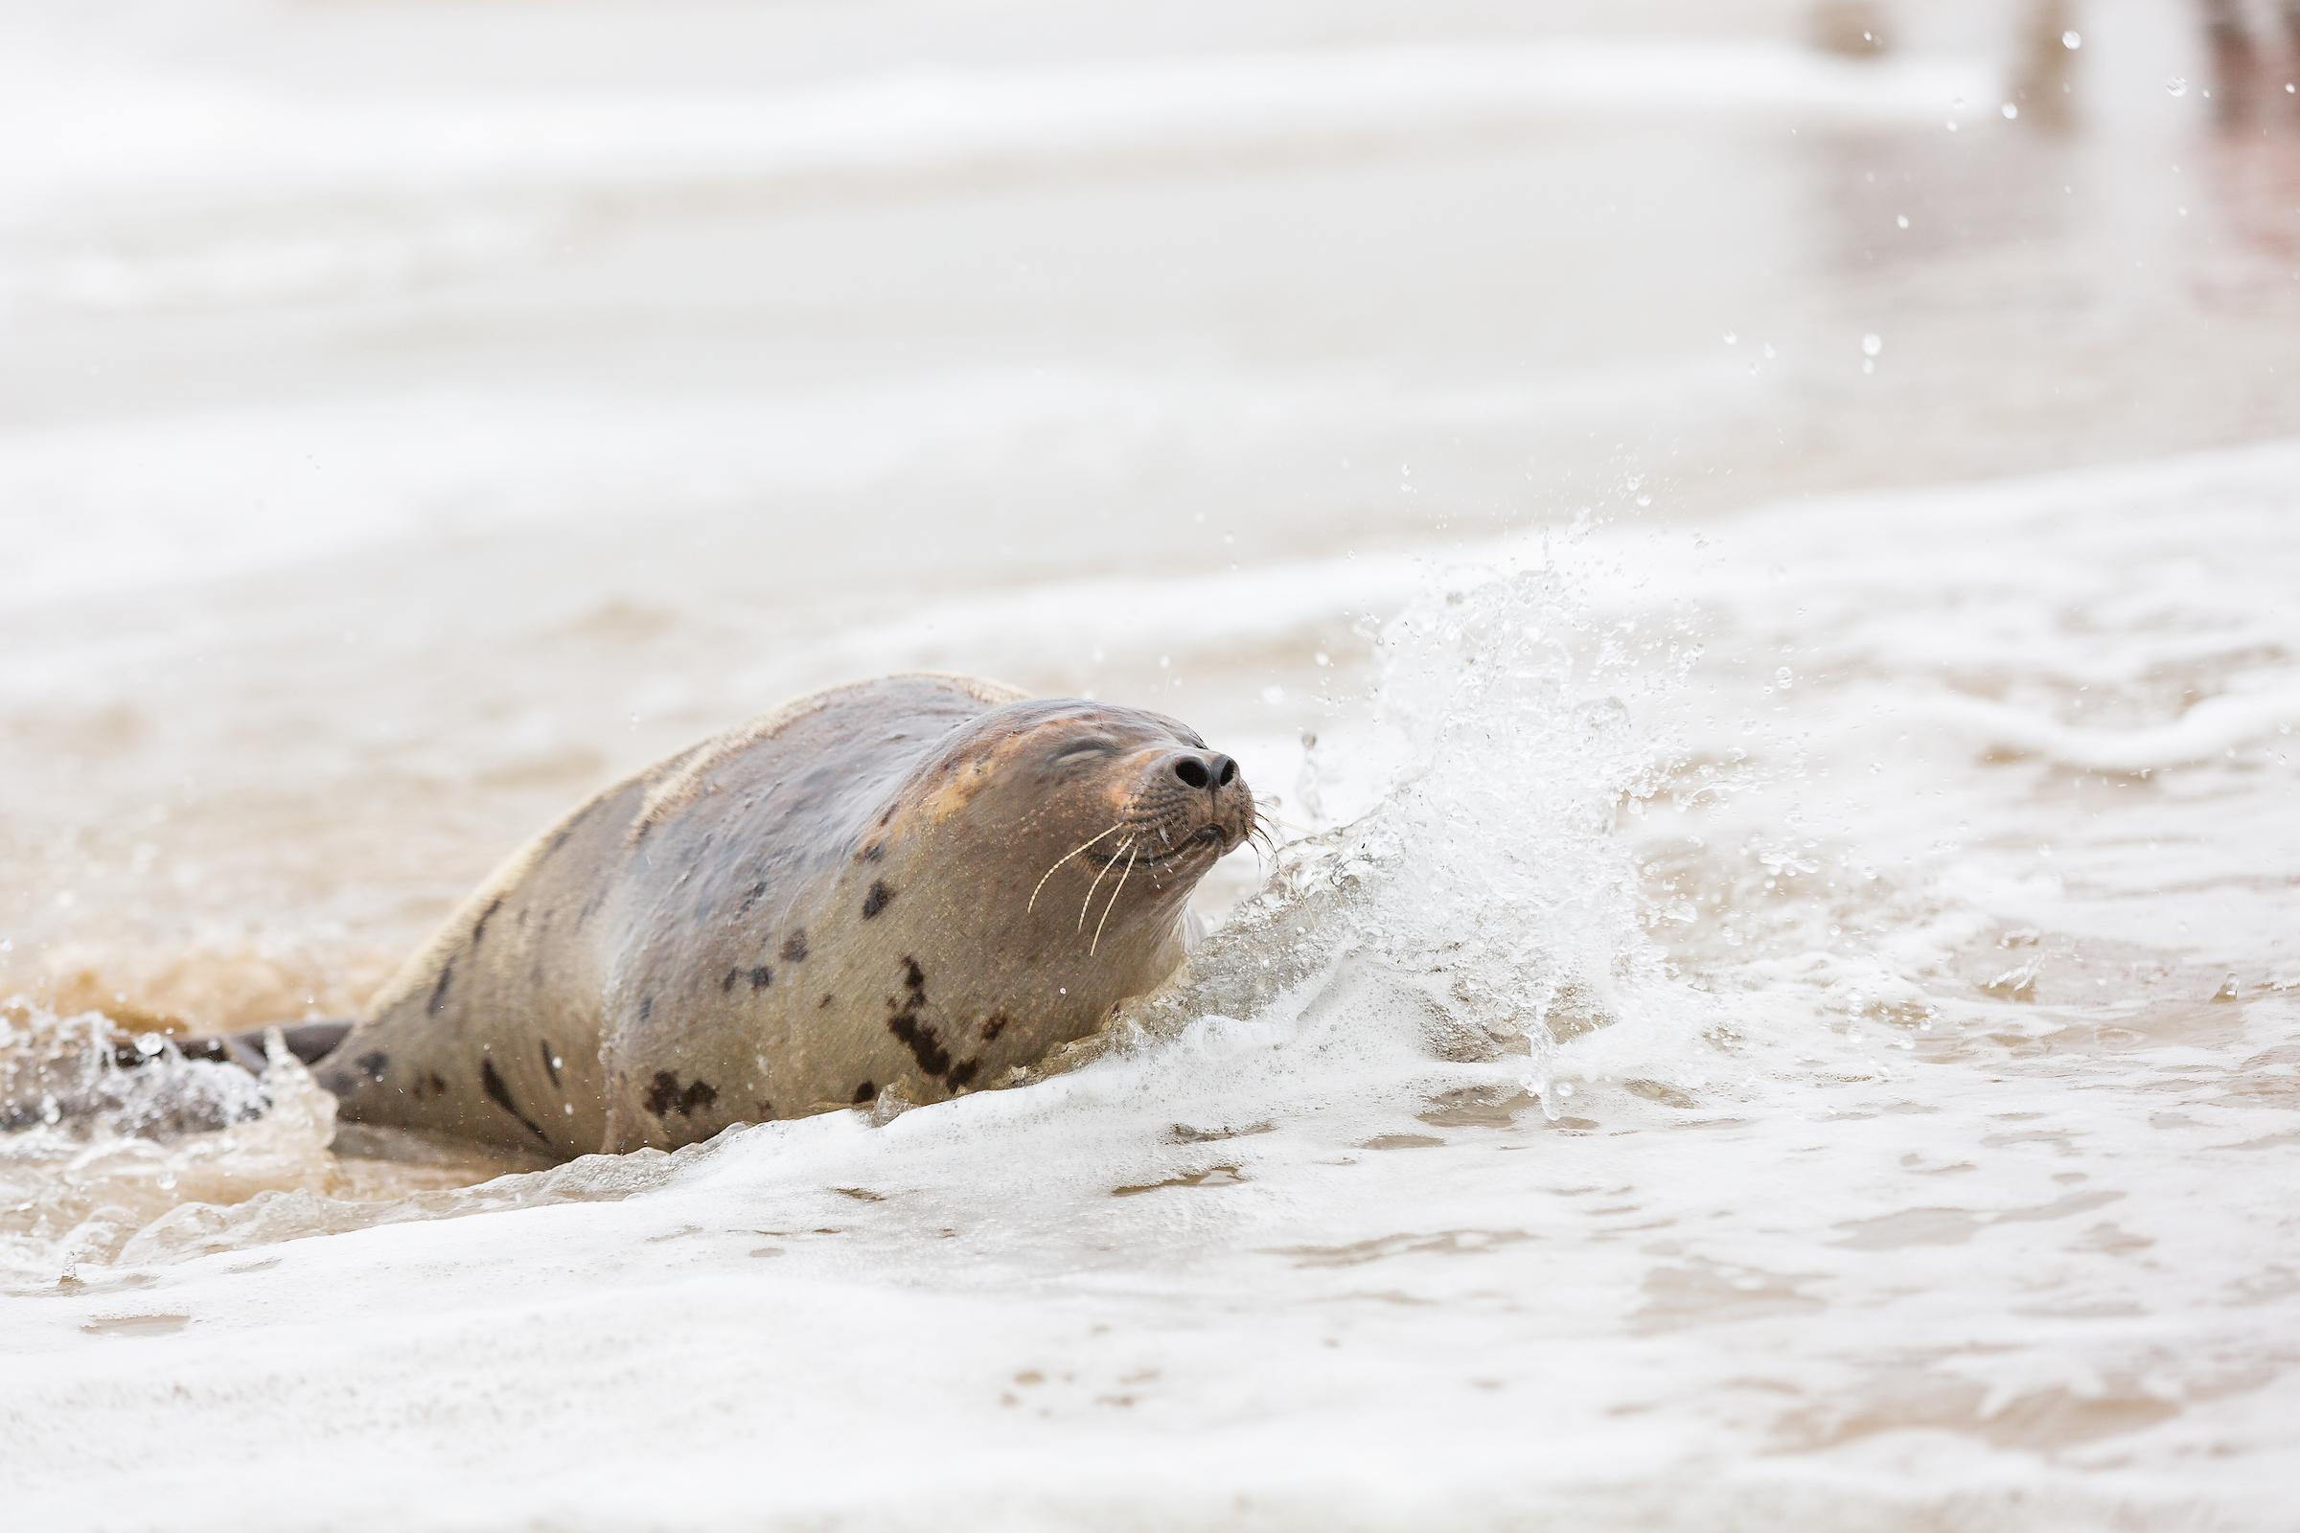
Questions?
David Coffey/National Aquarium
Authority: 112(C) Stranding Agreement
Notes:
David Coffey/National Aquarium
Authority: 112(c) Stranding Agreement

