Slide 1
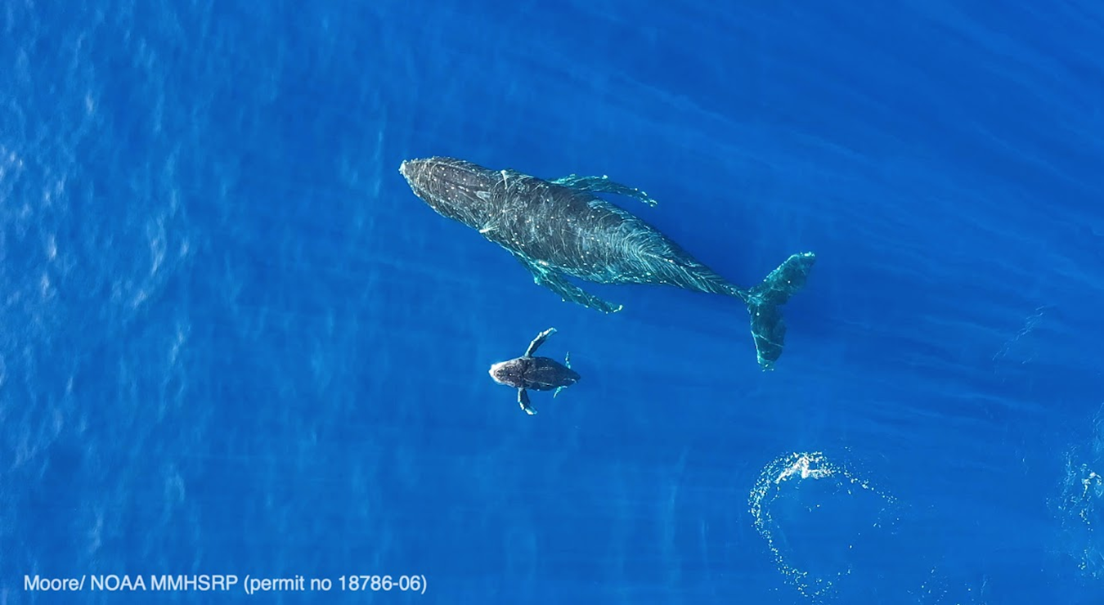
John H. Prescott Marine Mammal Rescue Assistance Grant Program Pre-Award Webinar
2023
Notes:
Welcome to the Prescott Grant pre-award webinar. All the informational links in this webinar can be found at the end of this presentation. A checklist document with useful information from this presentation is also available on the Prescott website to help you with your applications.

Slide 2
Pre-Award Webinar Goal & Objectives
Help Organizations to Apply for a Prescott Grant:
About Program
FY24 Competition
Know Application process
Correctly Fill Forms
Provide Documents (recommended order)
Submit Complete Application (by Oct. 19*)
Notes:
The purpose of this webinar is to help applicants learn about the Prescott Grant Program, to inform you about the competition updates for 2024, and help you to understand how to submit an application. Please note that we have extended the deadline from Oct 12 to Oct 19. This is due to a Grants Online data transition to the new grants mgmt systems GEMS/eRA Commons, from Oct 6-11, which will limit the Prescott Prgm staff’s access to view incoming applications during that time.

Slide 3
Prescott Grant Program
Established in 2001 under the Marine Mammal Protection Act (MMPA)
Provides grants or cooperative agreements to eligible stranding/entanglement network participants for:
Recovery & treatment (i.e., rehabilitation) of stranded/entangled marine mammals
Data collection from living or dead stranded/entangled marine mammals
Facility upgrades, operation costs & staffing needs directly related to the recovery and treatment of stranded marine mammals
Notes:
A little background about the Prescott Grant Program. The program was established in 2001 to provide funding for rescue & rehabilitation, data collection, and operational costs for the marine mammal stranding network

Slide 4
2002-2022 Total Funding > $71.3 mil (843 awards)
Avg $3.7 mil
Notes:
From 2002-2022 the Program has provided over $71.3 million in funding for a total of 843 awards. During this time congress authorized up to $4 mil/yr in funding. The actual appropriation in a recent 4 year period, from 2019-2022 has averaged ~ $3.7 mil. In 2023 the Program authorized up to $6 mil. However, the appropriation of funding to support grants and emergency Prescott requests was $4.5 mil.

Slide 5
2024 Prescott Grant Competition
NOAA GAR 2023
Notes:
Now I’ll talk about the 2024 competition

Slide 6
FY 2024 Timeline
July 14, 2023: NOFO published on Grants.gov
October 19, 2023, 11:59 EST: Deadline Submission for Grants.gov
Federal Program Officers (Artie, Mackenzie, Steve)
October 2023 -January 2024: Minimum Reqs & Tech Review
March-April 2024: Program Review & Selection
April-June 2024: Negotiations and Revisions as Needed
Grants Mgmt Division (Michele)
June 2024: Revised Proposals Received
July-September 2024: Review & Issues Awards
Notes:
This is the basic timeline for the program. It shows the major phases that Mackenzie, Steve and myself work on. As well as, our Grant Specialist, Michele. We work closely with the Grants Mgmt division to review selected proposals so that they may be awarded.
…….(go through slide bullets). So you know. No contact during negotiations and revisions means we don't need revisions to your application, it does not have anything to do with being selected for an award.

Slide 7
Program Updates for FY24
Max award is now $150,000 ( $50k)
25% match for $150k award = $50k
1 Year Project Period
No Multi-Year Proposals
Extensions Only As Needed
Diversity Equity & Inclusion
Standalone section of application (2-page limit)
5% of Total Score in Technical Review
Notes:
For those of you who attended Sarah’s Marine Mammal Research & Response Act presentation or MMRRA, last week. You would have heard that one of the major updates for the Prescott Grant Program was the increase in maximum award funding. For this year we will increase the maximum federal award to $150k. The 25% minimum match for the max award amount is $50k. There will be no multi-year proposals allowed for 2024. Please do not submit a proposal that will require multiple years to complete, with a plan to apply for No Cost Extensions each year. No Cost Extensions will still be granted as needed for a one year proposal, and as always there is no penalty for receiving an extension. For the DE&I we have provided a 2-page stand alone section to summarize your organization’s DE&I policy & efforts. Furthermore, DE&I will be worth 5% of your application’s total score during Technical Review.

Slide 8
Funding Priority Updates for FY24
National Funding Priority Updates:
Cat A1, Climate Change Impacts
Cat A2 and B2, Address Compassion Fatigue
Cat B2, Enhance Data Mgmt & Processing
Regional Updates:
West Coast Region- Improve Large Whale Disentanglement Response
Operational Funding
Fuel & Vessel
Level 3 & 4 Responder Salaries
Tools & Safety Gear
Notes:
For Category A1 we have added research on Climate Change Impacts as an additional priority. A2 and B2 will include support for Compassion Fatigue which is generally characterized by emotional, mental, and physical stress and trauma from the work we do, responding to sick, injured, and dead marine mammals. For Category B2 there is a priority to enhance data mgmt & processing. In the West Coast Region there is a need for improved Large Whale Disentanglement Response, and proposals may include operational funding such as fuel, salaries, and gear. I will discuss the different Categories some more later in the presentation.

Slide 9
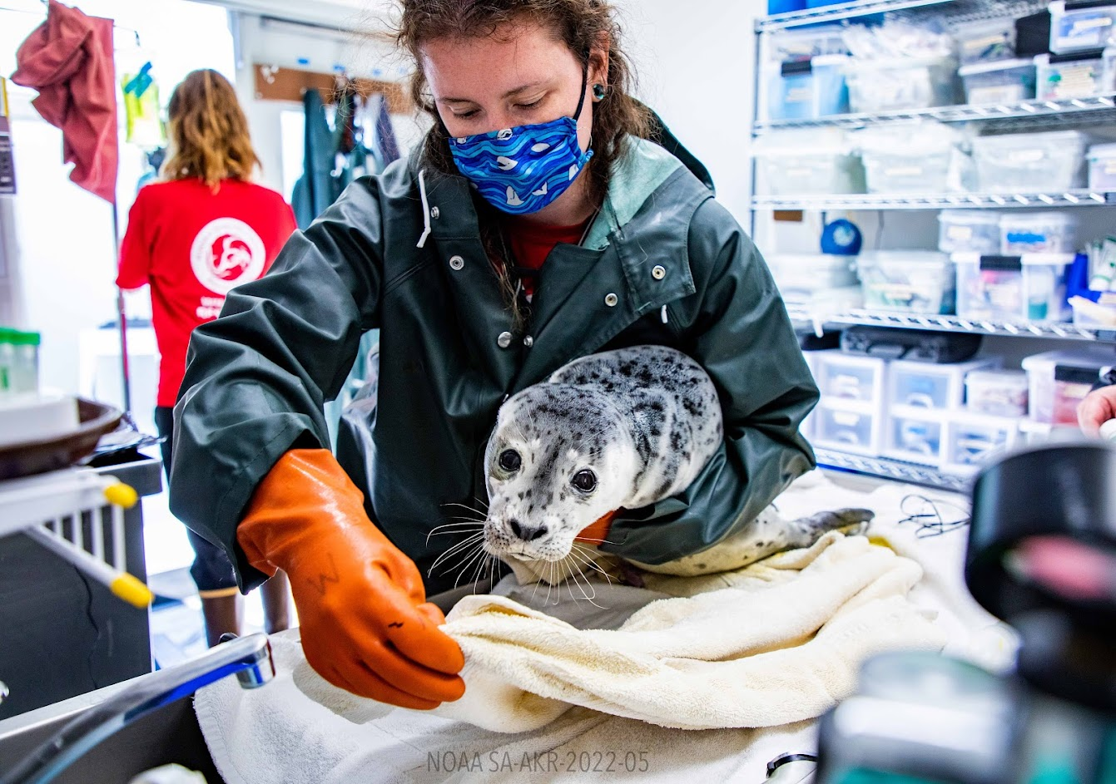
Required Organization Registrations
Alaska Sealife Center 2022
Alaska Sealife Center 2022
Alaska Sealife Center 2022
Notes:
Now we’ll go over the registration process

Slide 10
Required Organization Registrations
Login.gov Needed to Access SAM.gov
Extra Security for Multiple Systems
Use Same Email Address as SAM.gov Registration
Email You to Verify Your Email Address
Cell Phone Text Verification to Complete Registration
System for Award Management (SAM) – (10 days) Issues 12-character unique entity identifier (UEI) for SF-424
Grants.gov – Submit Online Grant Application Here
eRA Commons – New Grant Mgmt System (4 weeks)
Notes:
There are several websites your must register your organization with. Login.gov is a website designed to provide additional security for your Organization’s information. This registration is used to access many other federal websites including SAM.gov. SAM.gov provides your organization’s identifier number so that you may receive your grant funding. For SAM they say registration takes ~ 10 days but as we have seen it has taken much longer. Grants.gov is where you will submit your online grant application, and eRA Commons is the new grant mgmt system where are all moving to, from Grants Online. Links are on this slide, but again all links will be provided at the end of the presentation and in a checklist document.

Slide 11
Login.Gov
Notes:
This is what the Login.gov website looks like

Slide 12
SAM.GOV
Notes:
This is what SAM.gov website looks like.

Slide 13
Notes:
Here is a diagram showing how your organization’s identified number is used for you to receive grant funding. There are multiple platforms that will require the number. This diagram shows Grants Online, but as I mentioned before it is being replaced by eRA Commons.

Slide 14
Grants.gov Authorized Representative
Whoever Signs as Authorized Representative in Grants.gov = Account Holder of Grants.gov Workspace
Responsible for Negotiations, Revisions & Acceptance
Must Be Same Person Identified in All Forms
Name in Information Boxes & Signature Name at Bottom Must Match
Notes:
For the Grants.gov website the Authorized Representative for your organization should register their name as they will be the account holder responsible for proposal negotiations and revisions, and they will be the name signing off on all the federal forms.

Slide 15
Grants.gov
Notes:
This is what the grants.gov website looks like

Slide 16
Register Grants.gov
Notes:
There is a registration video on youtube available

Slide 17
eRA Commons & Registration FAQs
Applicant’s grants management site
Registration must be someone with signature authority to legally bind the organization in grants administration matters (such as Authorized Rep)
One Time Registration Process
Notes:
eRA Common’s is your new grants mgmt website. We recommend the Authorized Rep register here as well. Remember that it can take 4 weeks for your eRA Commons Registration to process. This is a one-time registration process.

Slide 18
www.era.nih.gov
Notes:
Here is the eRA Commons website. It is an NIH system that has worked with NOAA to develop a platform tailored for NOAA Grants.

Slide 19
Register eRA Commons
Notes:
Here is the registration page.

Slide 20
Help at Bottom of eRA Commons Website
Notes:
Help may be found at the bottom of the website. All help desk info for the different registration sites will be provided for you.

Slide 21
eRA Commons Webinars
Introduction to eRA for External Users – Introduction to eRA for External Users Webinar Recording
eRA Commons Registration – eRA Commons Registration Webinar Recording
Notes:
Here are a couple of eRA info and registration webinar links.

Slide 22
Grants Online Moving to eRA Commons
October 2023 All Active Awards Will Be Managed in eRA Commons
FY24 Prescott Competition - Applications Received & Processed in Grants Online, then Awarded in eRA Commons
FY25 NOFO, Applications & Awards in eRA Commons
Notes:
The basic timeline for the move from Grants online will be as follows: (read bullets). Initial applications will still be submitted through Grants.gov

Slide 23
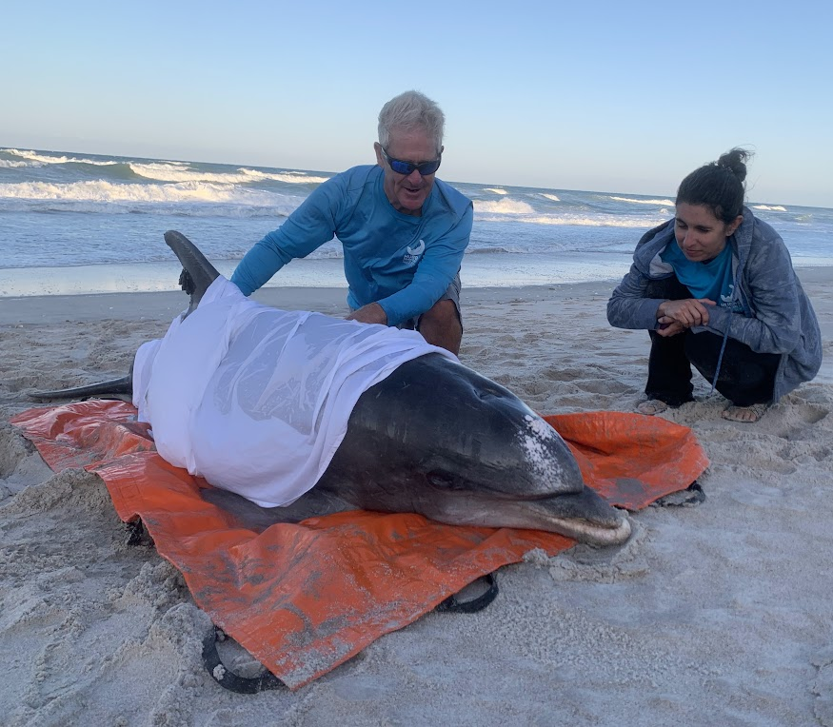
Applying for a Prescott Grant
HSWRI 2022
Notes:
So let’s talk about applying for a Prescott Grant

Slide 24
2024 Prescott Grant Application Tips
October 19, 2023, 11:59 EST: Applications due in Grants.gov
Review Application Checklist on Prescott Website
SUBMIT EARLY (≥ 3 days)
We will review for minimum requirements
Time permitting we can recommend corrections if needed
Notes:
Go through bullet points

Slide 25
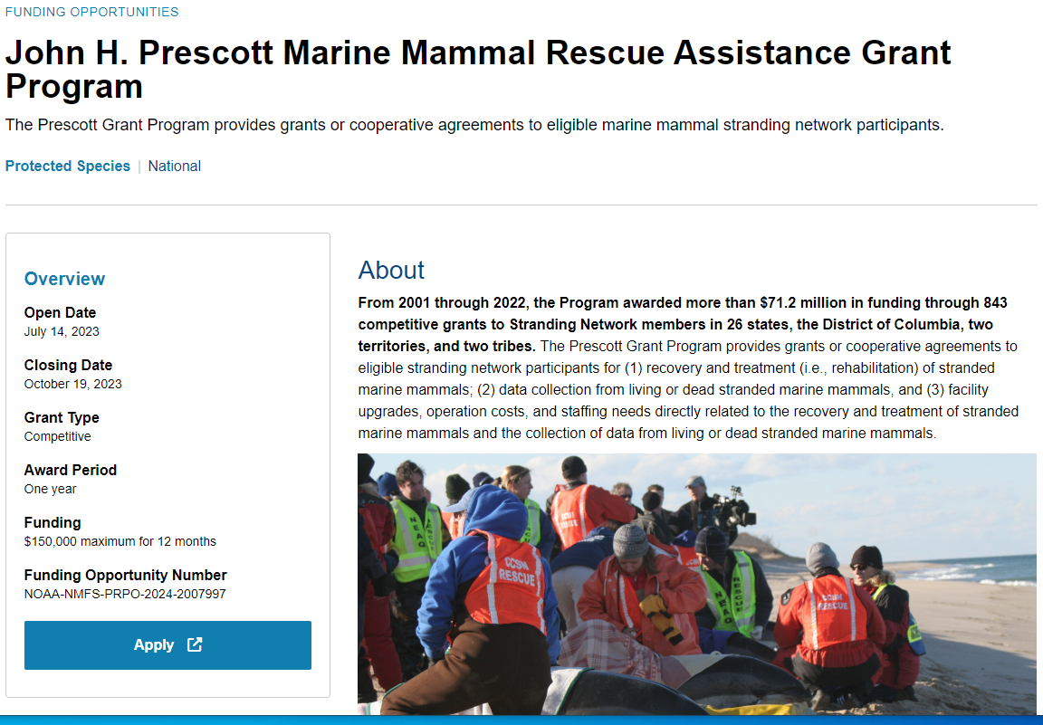
Prescott Website
Notes:
If you go to the Prescott website and click the blue apply button it will take you to the NOFO in Grants.gov. Please take the time to read the NOFO. It is a large document...we are planning to make it easier to read in future with more text graphics available in the new Grants Mgmt system.

Slide 26
Go to Related Documents

Slide 27
Go to Package > Preview

Slide 28
Preview > Forms
Notes:
All the federal forms will be filled out and submitted in Grants.gov by your organization’s authorized rep.

Slide 29
Apply

Slide 30
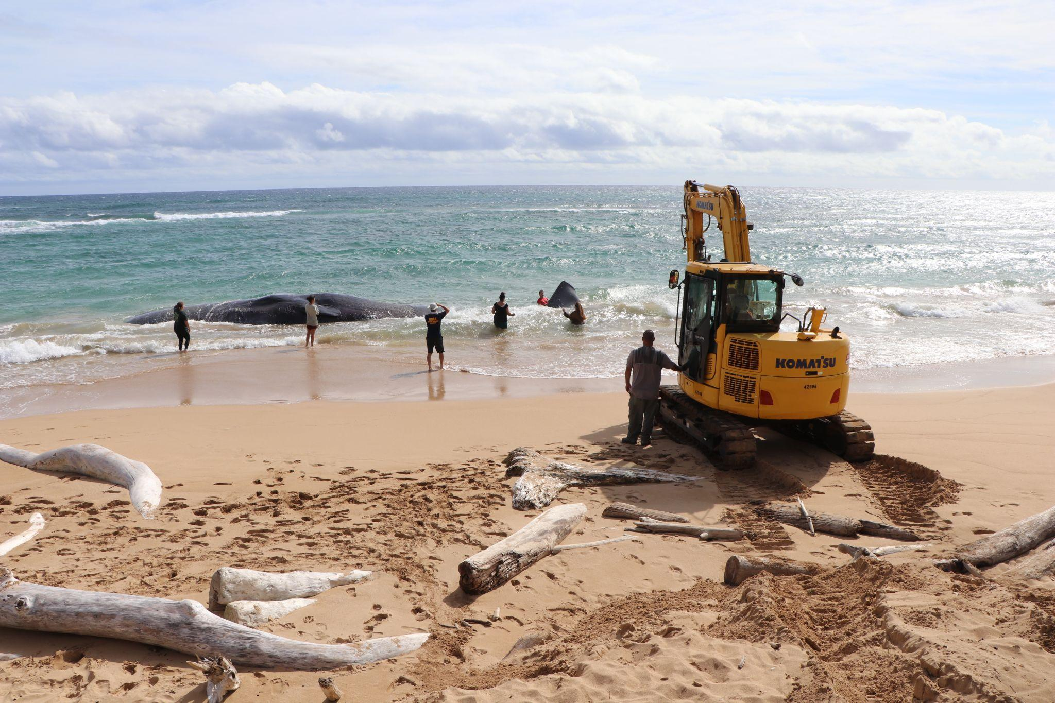
Prescott Grant Application
Forms & Budget
PIR DLNR
Notes:
Now we will discuss details about how to fill out the federal forms and writing your proposal budget

Slide 31
Federal Forms
SF424: Your Org’s Info is imported into Grants Online/eRA Commons via Grants.gov
SF424A: Budget
SF424B: Non-Construction Assurances
CD511: Certification Regarding Lobbying (acknowledge that funding is not used to influence anyone in Congress)
SFLLL: Lobbying Disclosure* (only if a member of Congress has or will received funds you should report here)
All forms MUST have the same Authorized Representative signature as the SF424 form
Notes:
This is a brief overview of what the forms are for.

Slide 32
Budget Narrative & Budget Table
(How files will be combined into a single PDF)
Budget Narrative (no page limit)
Budget Table
Negotiated Indirect Cost Rate Agreement (NICRA) *
Equipment Quotes (single item ≥ $5000 )*
Position Description (funding a new staff or intern position)
* Not Required in Application, but suggested. Will be needed if selected
Notes:
We understand that Grants.gov has certain fields where you must save your files in order to proceed with application submission. Following your submission, we will be organizing application files according to the list below, so please keep this in mind when saving & submitting your files

Slide 33
SF424 Application for Federal Assistance
Basic applicant/organization information
Proposed funding (Federal and Applicant Match ONLY)
Project Title & Description
Authorized Representative (Point of Contact)
Responsible for Negotiations, Revisions & Acceptance
Name in Information Boxes & Signature Name at Bottom Must Match
Notes:
The most common errors we see are:
authorized representative signature not matching with the name in the form
and the Match amount being incorrect. Even if it is off by $1 you will have to go back and correct it. We cannot do it for you.

Slide 34
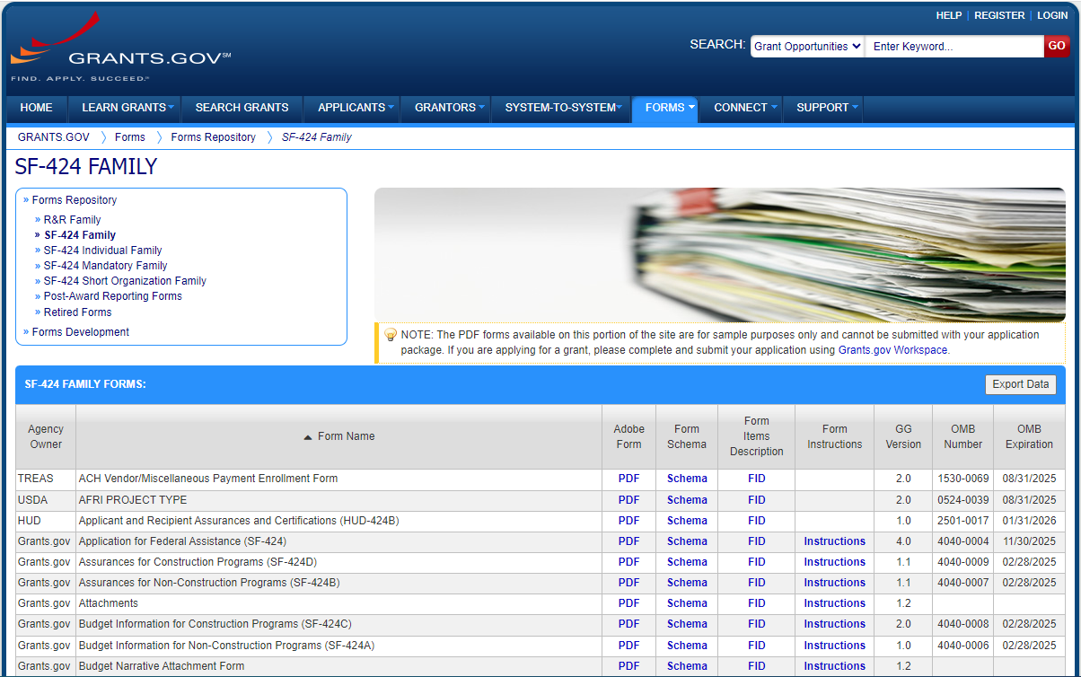
Grants.Gov: Form Instructions

Slide 35
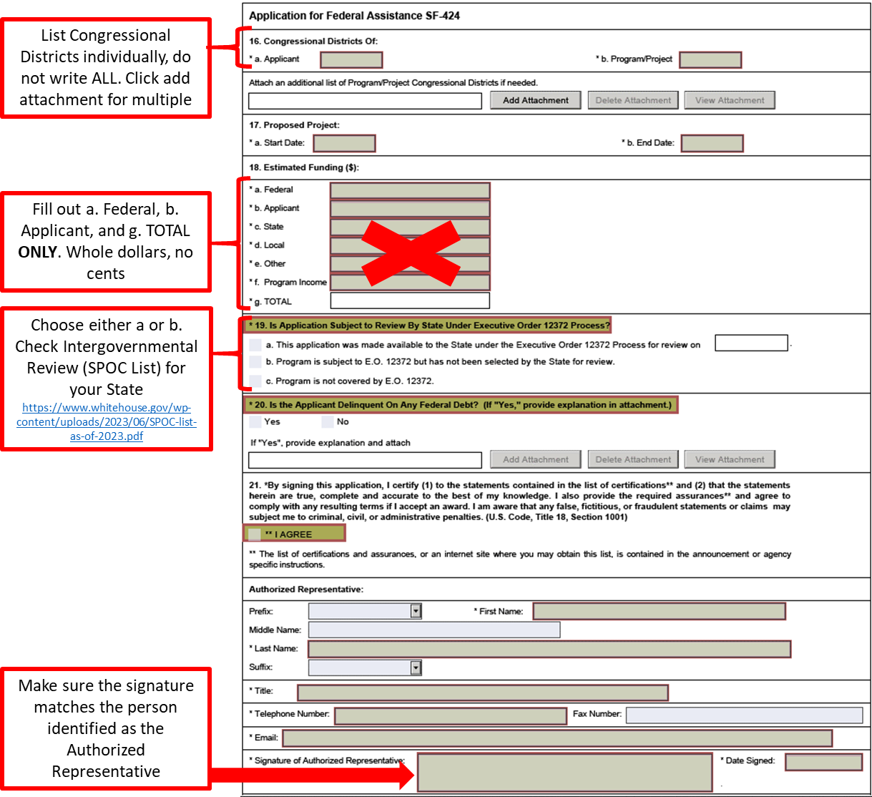
SF-424, Page 3
Notes:
The form pictures will also be in the Checklist document. For questions 19. The Prescott Program is eligible for coverage under E.O. 12372, "Intergovernmental Review of Federal Programs." Check the SPOC List if your State has selected the Prescott Program for review. That link will be available at the end of the presentation and in the Checklist document. https://www.whitehouse.gov/wp-content/uploads/2023/06/SPOC-list-as-of-2023.pdf

Slide 36
SF-424, Page 3 (Signature)
Box 21: Please make sure the signature matches the person identified as the “Authorized Representative”

Slide 37
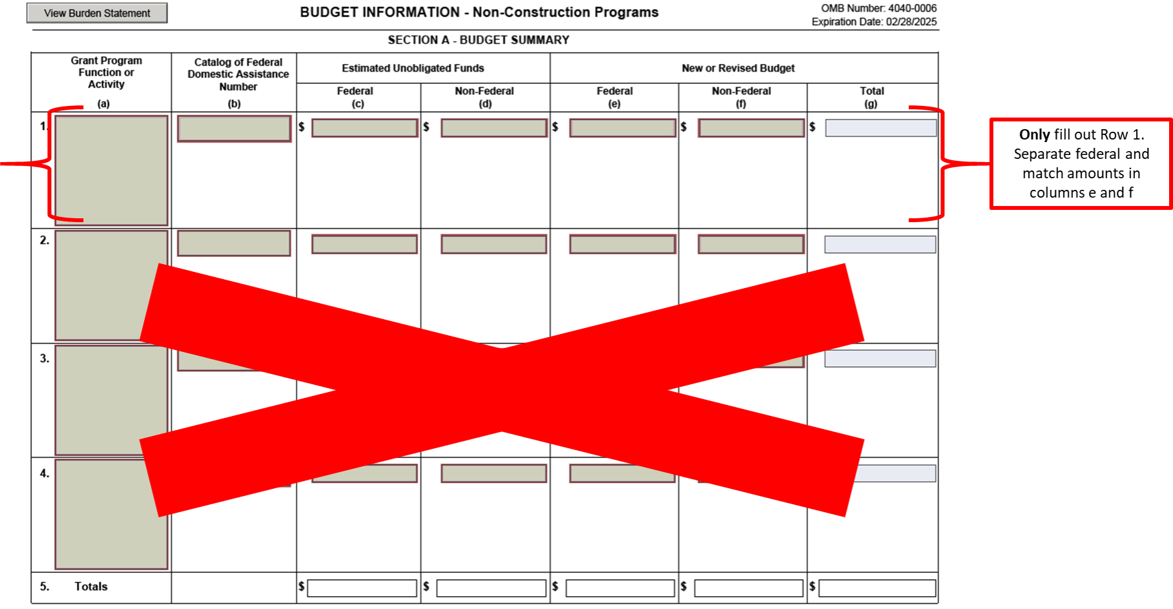
SF-424A Budget Information, Page 1

Slide 38
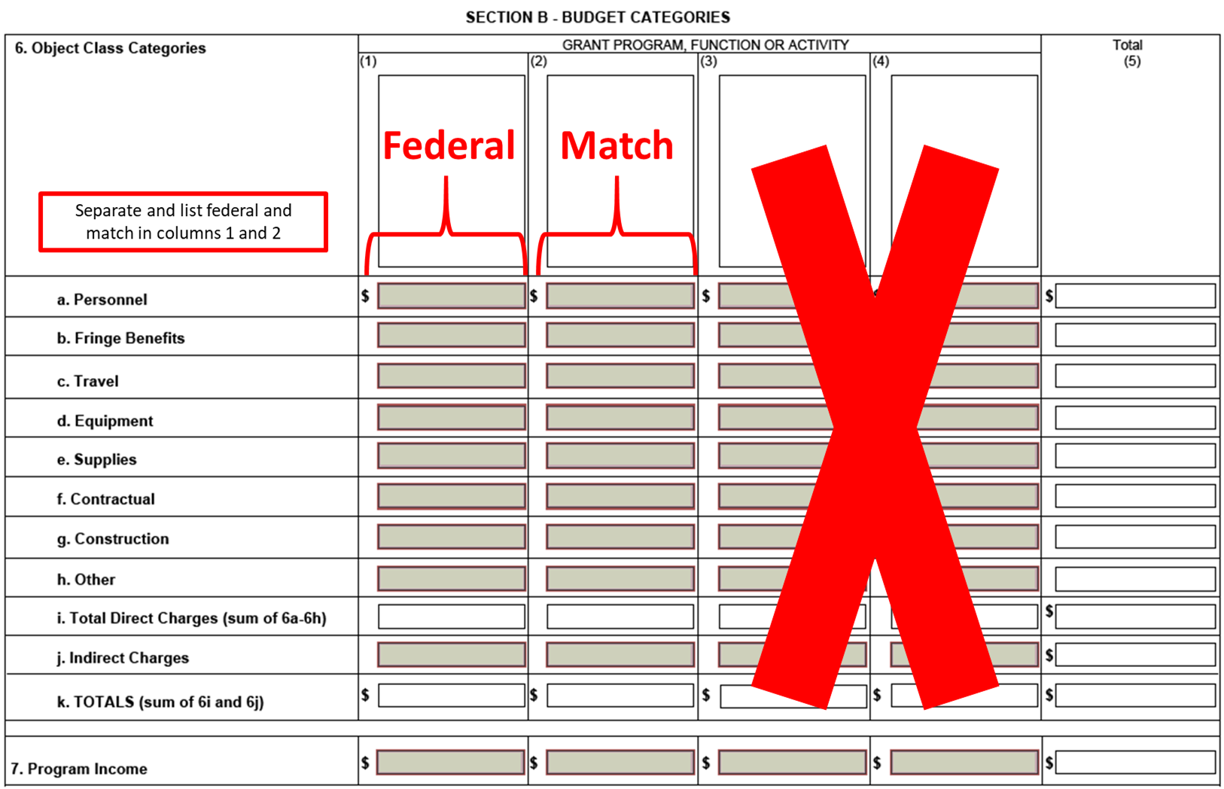
SF-424A Page 2

Slide 39
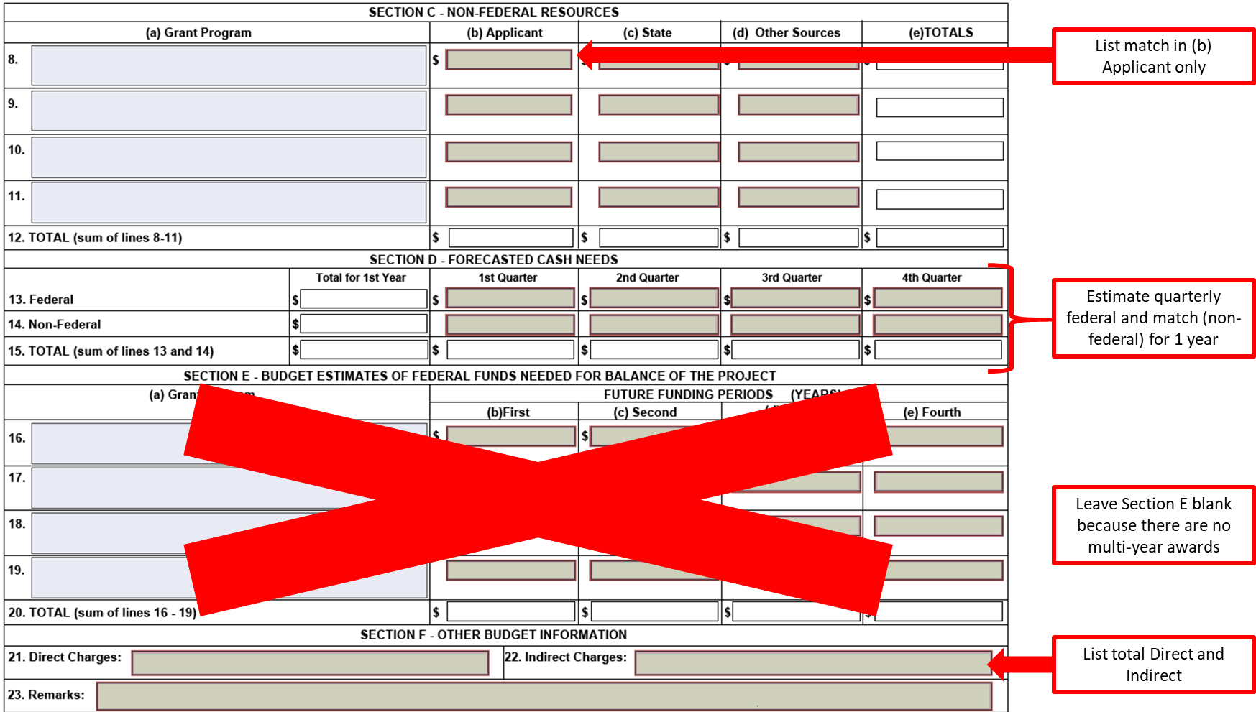
SF-424A, Page 3

Slide 40
Budget Specifics
Sample of SF-424A provided on the Prescott Grant website
Both Budget Narrative & Budget Table are required
Budget table provides breakdown of categories listed in SF-424A
Salary & Wages in salary line
Everything else in Fringe Benefits line (payroll taxes, FICA, Medicare, insurances, leave, etc.)
Fringe > 35%, provide a description & breakdown of what’s included in the rate for each position
Notes:
In general, GMD will want to see a breakdown of everything, as a matter of DOC. The > 35% is a specific federal regulation.

Slide 41
Budget Specifics from Grants Mgmt Division
All $ amounts discussed in your budget, should be the same in the budget narrative, budget table, and the SF424A.
In your budget table provide a breakdown for a supplies budget of $5000 or more
For other costs show how you estimated the cost regardless of the amount. For example if you have $1000 for sample analyses, please show how you calculated that amount.
The Authorized Representative must be the same person for all of the signed forms.Whoever logs into Grants.Gov is the Authorized Representative. All form signatures will become that name.
Notes:
One of the reasons for the specific budget breakdowns is because the agency is frequently audited and auditors would like to see this information.

Slide 42
Budget Specifics (cont’d)
If no fringe or indirect costs are included in your budget, please provide a sentence stating that indirect costs are not needed and the reason why. For example: Indirect costs are not needed and will be covered by another part of our program.
SAM.gov registration must be current. If it expires, the renewal can take months.
Please see the NOAA Grants-Budget Narrative Guidance pdf for additional information
Notes:
Some more specifics from GMD

Slide 43
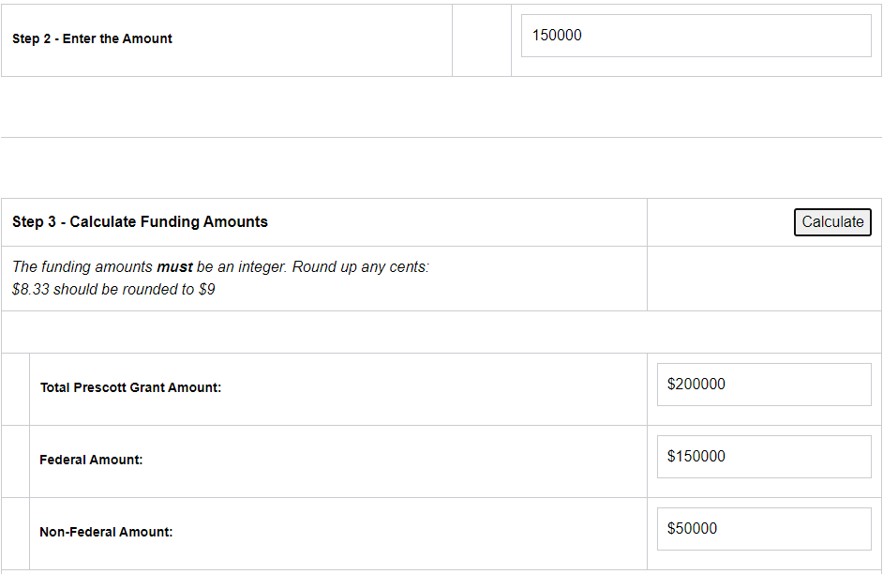
25% Non Federal Funding (Match)
Ensure match is accurate
Prescott Cost-Share Calculator
Notes:
You should calculate your minimum match amount for your proposal by going to the Prescott Cost-Share Calculator. Enter the Federal award amount, and then click Calculate. In this example you see the max Fed amount fo $150 thousand, and the calculated non-federal match amount of $50k.

Slide 44
Volunteer Rates
Volunteer rates belong in the personnel category
Current Rates: Independent Sector
National or state value, whichever is higher
Notes:
Determining the volunteer rates for your match support, can be found on the website Independent Sector. You may choose the National or State value, whichever is higher.

Slide 45
Indirect Costs
Do you have a Negotiated Indirect Cost Agreement (NICRA)?
If so, make sure it is valid at least through August 2024
If not, use the 10% de minimus rate
Do not include equipment costs as part of your indirect cost calculations
National Fish and Wildlife Foundation (NFWF) Indirect cost calculator
Individualized NICRA determined by cognizant agency - Federal agency with the largest dollar value of Federal awards directly funded to an organization
NOAA NICRA contact Raishan Adams, Branch Chief and Grants Officer, raishan.adams@noaa.gov
Notes:
What are Indirect Costs? Indirect costs include costs which are frequently referred to as overhead expenses (for example, rent and utilities) and general and administrative expenses (such as accounting department costs and personnel department costs). Budget Narrative Guidance for NOAA Grants document has more information and the link is provided at the end of the presentation and in the Checklist.

Slide 46
Proposal Narrative & Supporting Docs
DPMMR 2022
Notes:
So we have gone through budget information and tips, now we are going to discuss the details of your proposal narrative and supporting documents

Slide 47
Proposal Documents (Single Combined PDF)
Proposal Title page (1-page limit)
Proposal Narrative (10-page limit)
Organizational Summary (3-page limit)
Data Sharing Plan (2-page limit)
Statement of Diversity and Inclusion (2-page limit).
Appendices(15-page limit)
Supporting Documentation (no page limit)
Notes:
Here again we are recommending the proposal documents be saved together in a single combined PDF.

Slide 48
Choose Category: A or B
Category A: Research Projects or Diagnostic Laboratory Services
A1: Research Proposals
A2: Diagnostic or Service Organizations
Category B: Stranding or Entanglement Response (Operational Activities)
B1: New Applicants never applied for Prescott funding before
B2: All other eligible organizations
Proposals may have components of both categories but the majority of the federal request will determine the category to apply under
If B proposals have research objectives they must have a testable hypothesis
Notes:
Here is information about the different Categories of funding for Prescott. Category B may have research objectives but as with all science based research there will need to be a testable hypothesis. For example: Are there more strandings in the Spring than the Winter?

Slide 49
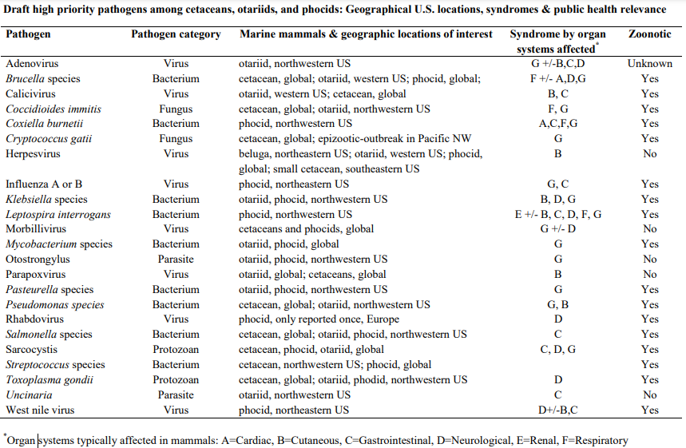
List of priority pathogens-Prescott Website Supplement under FY2024 Prescott Grants

Slide 50
National & Regional Funding Priorities
Proposals prioritized by how well they meet national or regional priorities listed in NOFO
Develop proposals according to NOFO priorities
No advantage for multiple priorities, so list only those priorities your proposal is specifically designed to address.

Slide 51
Application Format Requirements
Example documents at bottom of Prescott FAQs
10-point font (i.e., do not use 8 or 12-point)
Double spaced
1 inch margins
Adhere to section page limits
Do include: eligibility letter from RSC, CI letter for research permits/parts authorizations (cover letters), single-page equipment quotes
Do Not include: extraneous documents -- i.e., stranding agreement, entire permit, entire equipment catalogs, IRS document (501c3)

Slide 52
Title Page
Keep it simple
Clearly Identify One Category (A or B)
Identify National and Regional Priorities but no need to copy them here (e.g., “Regional Priority 1(a)”)
Include a summary of the project goals & objectives in 3-4 sentences, which will be used on government websites if awarded
Do Not put proposal title in ALL CAPS!
Notes:
Examples are in FAQs

Slide 53
Project Narrative
Project Narrative: For reviewer learning about your organization & project for the very first time
Goals & Objectives: Restate Category & National & Regional priorities
Project Management: Identify Principal investigator (PI), Co-Investigators & Cooperators - Explain how PI will manage project
Page limit: 10 pages
Concise & Clear: Easy to understand with clear objectives and funding justifications

Slide 54
North American Association for Environmental Education (NAAEE guide to reach target audiences)
Notes:
The NAAEE may be used to help develop your proposal and objectives with regards to reaching target audiences.

Slide 55
Organizational Summary
A sample organizational summary is on the Prescott Grant website
Include maps, statistics, organization overview, size & capacity of facility
Explain your role in the network & how you work with your network partners
Provide financial overview of the facility

Slide 56
Data Sharing Plan
Required by NOAA
Data management guidance is available on the Prescott grant website
Minimum Expectations:
Level A, Rehab & HI data entered into the National Database
Level B & C data held by organization
Examples of Data Sharing: fulfilling requests, websites, presentations, journals, posters, educational outreach, etc.
Notes:
We will eventually use B & C data for Health Map. Given it is now a national priority you can propose organizing and entering data, as an objective in your proposal

Slide 57
DE&I Statement
Diversity = Individuals Working Together
Inclusion = Culture Connecting Each Employee w/ Organization
Hiring practices, recruitment efforts, support of employees and interns/externs (i.e., equitable pay, health benefits, paid time off)
Organizational policies that prohibit discrimination
Outreach and education to groups underrepresented in STEM
Current inequities within your organization & efforts to improve

Slide 58
Appendices
15-page limit (excess pages will be removed)
Should include additional materials in support of project goals & objectives
Do include relevant: tables, charts, graphs, maps, photos, brochures, educational/outreach materials
Do Not include: entire Stranding Agreement, 501c3, entire permit, catalogs

Slide 59
Supporting Documentation
Prescott Letter of Eligibility (ask your Regional Coordinator)
Results of Previous Prescott Awards in the past 3 yrs
CVs or Resume (4-page limit)
Letters of Collaboration (project partners outside of organization acknowledging participation)
Letters of Support (optional, 5-letter limit. AKA Letters of Recommendation)
Permits, Authorizations, IACUC Approvals, and Complete Environmental Analyses (No Stranding Agreement & 501c3)
Notes:
Cover letter for permits

Slide 60
Hardship Exemption Request
An extension past the deadline (up to 2 weeks) may be granted on case-by-case basis with approval from the program office due to
Natural or anthropogenic disasters
Validated service disruptions in a specific area
Sudden acute severe illness or death of the Project Investigator/Authorized Representative or immediate family member
Contact Prescott Grant Prgm Mgr

Slide 61
Support Info and Reference Links

Slide 62
Registration Links
Login.gov
https://login.gov/
Sam.gov
https://sam.gov/content/home
Grants.gov
https://www.grants.gov/web/grants/applicants.html
eRA Commons
https://www.era.nih.gov/applicants
Introduction to eRA for External Users Webinar Recording
https://www.youtube.com/watch?v=DZDFZvN0SL8
eRA Commons Registration Webinar Recording https://www.youtube.com/watch?v=DZDFZvN0SL8

Slide 63
Supporting Links
Prescott Grant Program https://www.fisheries.noaa.gov/grant/john-h-prescott-marine-mammal-rescue-assistance-grant-program
Prescott FAQs
https://www.fisheries.noaa.gov/national/funding-and-financial-services/frequent-questions-prescott-grant-program
Prescott Cost-Share Calculator
https://www.fisheries.noaa.gov/grant/prescott-grant-cost-share-calculator
Independent Sector
https://independentsector.org/resource/value-of-volunteer-time
NFWF Indirect Cost Calculator https://www.nfwf.org/apply-grant/application-information/indirect-cost-calculator
Budget Narrative Guidance for NOAA Grants
https://coast.noaa.gov/data/coasthome/funding/_pdf/forms/budget-narrative-guidance-for-NOAA-grants.pdf

Slide 64
Supporting Links (cont’d)
Grants.Gov: Form Instructions
https://www.grants.gov/forms/sf-424-family.html
NAAEE’s Community Engagement Guidelines for Excellence
https://eepro.naaee.org/community/blog/community-engagement-guidelines-excellence
Congressional Districts
https://www.census.gov/mycd/
SF424 #19. Intergovernmental Review of Federal Programs (SPOC List) https://www.whitehouse.gov/wp-content/uploads/2023/06/SPOC-list-as-of-2023.pdf
High Priority Pathogens List 2011
https://media.fisheries.noaa.gov/dam-migration/high-priority-marine-mammal-pathogens-2011-prescott-grants-pr.pdf

Slide 65
ID.me
If you have an established ASAP account
Register with ID.me by 9/15
ID.me - enable multi-factor authentication for ASAP Account
Below are links to assist with your ID.me Registration:
See the ID.me Registration Guide
If you have any issues you may contact: asaphelpdesk@fiscal.treasury.gov
Notes:
Grant recipients with an established user account in ASAP must register and enable multi-factor authentication with ID.me no later than September 15, 2023. After September 15, grantees will not be able to log in to ASAP.gov until they successfully register for multi-factor authentication with ID.me. https://fiscal.treasury.gov/files/asap/ID-me-Guide-for-Recipient-Organizations-to-Register-and-Enable-Multi-factor-Authentication.pdf

Slide 66
SCAM ALERT
PLEASE BE AWARE of SCAMMERS POSING AS NOAA CONTRACTORS
THEY WILL ASK FOR $$$ TO ASSIST W/ GRANT REGISTRATION
DO NOT TALK TO THEM
ANY CONCERNS ABOUT NOAA GRANTS or FUNDING CONTACT US DIRECTLY

Slide 67
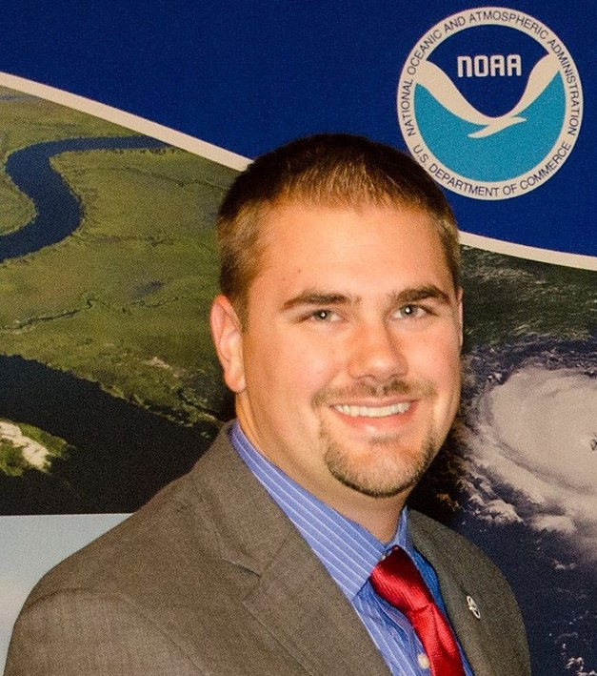
Prescott Staff & Contact Info
Arthur.Wong@noaa.gov
301-427-8454
Prescott Grant Prgm Mgr
Mackenzie.Griffin@noaa.gov
301-427-8418
Prescott Grant Prgm Asst & Biologist
Stephen.Manley@noaa.gov
301-427-8476
Prescott Support &
National Entanglement Response Coordinator

