Slide 1
Welcome to an Introduction to NMFS’s Multispecies Pile Driving Calculator. This PowerPoint is designed to be a basic tutorial on how to use this optional Tool. You may advance through these slides at your own pace.

Slide 2
Before you start, there are a few items of note, including that different Regions may have different requirements, please check with the appropriate Regional/HQ staff before using this tool. 1) This Tool was primarily designed for coastal pile driving activities, 2) Reading the Instruction Tab is recommended, and 3) Use of this Tool is optional. If you have more accurate means of estimating isopleths, please do so. Finally, this Tool provides a means to estimate distances associated with various NMFS thresholds. Mitigation and monitoring requirements associated with a MMPA or an ESA consultation or permit are independent management decisions made in the context of the proposed activity and comprehensive effects analysis, and are beyond the scope of this Tool.

Slide 3
There are some basic pieces of information needed to use this Tool. First, one must know what type of pile driving activity they are doing, either impact or vibratory. Proxy sound levels are also needed, but if unknown, NMFS provides help by the Tool having a Tab with surrogate levels. Note: Most proxy levels are specified at 10 m from the pile. If this distance is different from 10 m, this needs to be changed in the Calculator Tab. Transmission loss is needed, but NMFS provides help via a default value of 15 (practical spreading), if unknown. This default may be changed if transmission loss data are available. One must know the number of piles per day and either strikes per pile for impact pile driving or duration (minutes) to drive a pile using vibratory pile driving. NMFS suggests using a best estimate based on previous experience. If a bubble curtain or other attenuation device is being used, NMFS provides help via recommending a -5 dB default, unless better information is available

Slide 4
There are eight Tabs in this tool. Let’s start with the Instruction Tab, which you can access using the toolbar found at the bottom of the Tool.

Slide 5
The Instruction Tab provides instructions and a general overview of other tabs within the Tool. Tabs are organized by pile driving type: either impact (red) or vibratory (gray). Within each Tab, results are organized by species (fishes, sea turtles, or marine mammals). Within each Tab, the user provides information via green cells with output (isopleths in meters) provided in bright blue cells. Additionally in this Tab, note the various Assumptions listed. This Tab also includes a Contact for technical questions or suggestions, proxy sound level references, and threshold references.

Slide 6
The Acronym Tab can be accessed using the toolbar found at the bottom of the Tool.

Slide 7
The Acronym Tab provides various acronyms used throughout the Tool. It also provides a link to definitions of common terms used in the Tool.

Slide 8
Today, we will be walking through two examples, starting with an impact pile driving example (36” steel pipe piles, 3 piles per day, 1000 strikes/pile, with a bubble curtain).

Slide 9
Let’s demonstrate the Proxy Sound Level Tab for impact pile driving. Again, this Tab can be accessed using the toolbar found at the bottom of the Tool.

Slide 10
Note the various assumptions listed at the top of this Tab. This Tab is sortable by various pile features (size, material, etc.). Note the complete row of information provided for each pile, including water depth, location, reference, and comments. Please pick the proxy that is most applicable to your activity. If the exact pile size or material is not listed, consult NMFS or use next largest size. Copy the information from this Tab and then paste directly in the corresponding Calculator Tab (paste as a Value, 123). Note: If the measurement distance from the pile is not 10 m, then this value will need to be updated in Calculator Tab. If you have specific information on sound levels for your pile size/material, then it is not necessary to rely on a proxy.

Slide 11
To use the Proxy Sound Level Tab, it makes sense to sort data by appropriate pile size (hot pink arrow) and pile material (turquoise arrow).

Slide 12
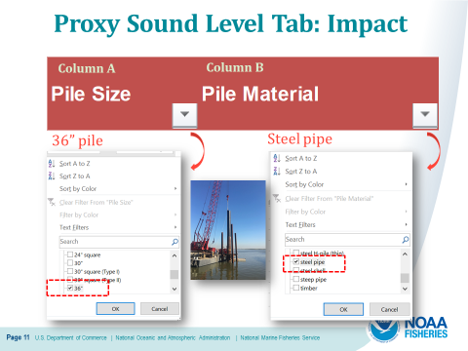
Here is a closer look at sorting columns, specifically Column A for pile size and Column B for pile material. In this example, we are interested in available data for 36” steel pipe piles.

Slide 13
Once data are sorted (by pile size and material), three potential choices for proxy levels are provided (see red box). To choose the most appropriate of the three, check water depth and other factors, such as location, notes, etc. to decide which most closely resembles your situation. For this example, all three choices are generic examples (no specified location). Since for this example, water depth is unknown, we will choose the 3rd row as the most appropriate proxy level. Once chosen, copy values in all three metrics (Peak, SEL_{ss}, and RMS) for this proxy. Note: Pay attention to the measurement distance from the pile if it is anything other than 10 m.

Slide 14
Let’s take a look at the Calculator Tab for impact pile driving. This Tab can be accessed using the toolbar found at the bottom of the Tool.

Slide 15
This slide illustrates the Key at the top of the Calculator Tab. Green cells are for user provided information. Note that default values are in bold italics turquoise font. These default values may be changed by the user if project-specific information is available. Yellow cells represent preset NMFS provided information and cannot be altered by the user. NMFS thresholds/default weighting values are in bold red. Bright blue cells represent outputs of the Tool or resultant isopleths based on user provided information and cannot be altered by the user. Finally, gray cells represent automatically calculated values based on user provided information (only weighting adjustment (-dB) values can be altered by the user and are found in the last row of the Tool). Please see Advanced Features later in this presentation for more information on adjusting these values.

Slide 16
This slide illustrates the first two steps of the Impact Calculator Tab. Step 1 outlined in hot pink, where a user will enter qualitative project-specific information and Step 2 outlined in turquoise, where the user will enter quantitative project-specific information. We will go into more detail on both these steps in the next slides.

Slide 17
Step 1 in the Calculator Tab is where the user provides general project information, such as project title and contact; source information such as pile size material, strikes per pile; and any other assumptions or notes, including if proxy levels were used or if any type of attenuation is assumed.

Slide 18
Step 2 is where quantitative project-specific information is entered, such as levels, distance associated with level, transmission loss, number of piles per day, number of strikes per pile, and attenuation assumed. Default values (italics, turquoise) are provided for distance associated with level and transmission loss. Please confirm these defaults are applicable. If not, they may be modified. Gray cells represent automatically calculated values based on user provided information (and cannot be changed in Step 2). The next slides go into more detail on Step 2 inputs.

Slide 19
Let’s take a closer look at some of the specific cells in Step 2 (labeled by row letter). Row A represents the unattenuated levels in three various metrics (Peak, SEL_{ss}, and RMS). Here a user may enter project-specific levels, if available or enter surrogate levels from the Proxy Level Tab. If values are copied from the Proxy Level Tab, paste them in Row A as a value (see red arrow). Row B represents the distance associated with the previously entered levels. The default value is 10-m, but one should ensure this is correct. This value may be changed if the default is not correct. Row C represents transmission loss. The default value is 15 and is recommended if this value is unknown. If site-specific transmission loss is available, it may be used here instead of the default.

Slide 20
Two additional rows are in Step 2. Cell D represents the number of piles per day based on best estimate from previous experience. Cell F represents attenuation, if being used. If it is unclear the appropriate decibel reduction associated with the attenuation method used, NMFS recommends a default of 5 dB. Please only enter positive numbers in this cell. If nothing is being used, please leave value as zero. Whatever attenuation is used will be reflected automatically in the attenuated levels (subtracted off levels entered on previous slide), as shown in the gray cells being illustrated by the red arrow. This will be illustrated further in the next slide. Finally, Cell E represents the number of strikes per pile based on best estimate from previous experience.

Slide 21
This illustrates all the green cells in Step 2. In this example, a bubble curtain is being used but attenuation is unknown. Thus, the NMFS suggested default value of 5 dB is being used (red circle; always enter a positive number). This attenuation is automatically subtracted from the unattenuated values entered previously, as illustrated in the gray cells. These attenuated values are used for calculating resulting isopleths, which will be illustrated next.

Slide 22
This slide illustrates all the values entered in Step 2 for our specific example.

Slide 23
After quantitative project-specific information is entered in Step 2 of the Calculator, resultant isopleths (bright blue cells) are produced by taxa.

Slide 24
This slide illustrates the Resultant Isopleths (bright blue cells) for fishes and sea turtles based on the various taxa-specific acoustic thresholds.

Slide 25
This slide illustrates the Resultant Isopleths (bright blue cells) for marine mammals based on the various hearing group-specific acoustic thresholds.

Slide 26
Let’s demonstrate the Impact pile driving Report Tab. This Tab can be accessed using the toolbar found at the bottom of the Tool.

Slide 27
The Report Tab summarizes the inputs and outputs provided in the Calculator Tab. The information in this Tab is designed to fit in a single sheet (landscape view). If other information or notes get cut-off from the what was provided in the Calculator Tab, please provide this information elsewhere.

Slide 28
Now, I will begin our second example: Vibratory pile driving (36” steel pipe pile, 3 piles per day, and time to drive a pile is 30 minutes)

Slide 29
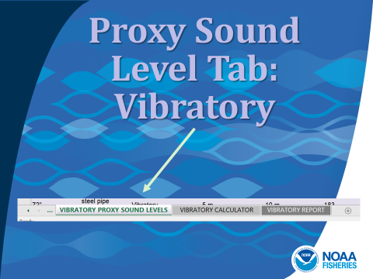
Let’s demonstrate the Proxy Sound Level Tab for vibratory pile driving. This Tab can be accessed using the toolbar found at the bottom of the Tool.

Slide 30
Note the various assumptions listed at the top of this Tab. This Tab is sortable by various pile features (size, material, etc.). Note complete row of information provided for each pile, including water depth, location, reference, and comments. Please pick the proxy that is most applicable to your activity. If the exact pile size or material is not listed, consult NMFS or use next largest size. Copy the information from this Tab and then paste directly in the corresponding Calculator Tab (paste as a Value, 123). Note: If measurement distance from pile is not 10 m, then this value will need to be updated in Calculator Tab. If you have specific information on sound levels for your pile size/material, then it is not necessary to rely on a proxy.

Slide 31
To use the Proxy Sound Level Tab, it makes sense to sort data by appropriate pile size (hot pink arrow) and pile material (turquoise arrow).

Slide 32
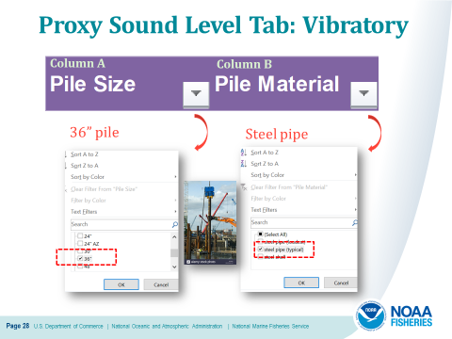
Here is a closer look at sorting columns, specifically Column A for pile size and Column B for pile material. In this example, we are interested in available data for 36” steel pipe piles. Since this is a more a generic assessment, we will choose steel pipe “typical” vs. “loudest.”

Slide 33
Once data are sorted (by pile size and material), one potential choices for proxy levels is provided (see red box). Since this is the only choice, it used as the appropriate proxy level. Once chosen, copy values in only the RMS metric for this proxy (Peak is provided but not needed, which is why this column has gray text). Note: Pay attention to the measurement distance from the pile if it is anything other than 10 m.

Slide 34
Let’s take a look at the Calculator Tab for vibratory pile driving. This Tab can be accessed using the toolbar found at the bottom of the Tool.

Slide 35
This slide illustrates the Key at the top of the Calculator Tab. Green cells are for user provided information. Note that default values are in bold italics turquoise font. These default values may be changed by the user if project-specific information is available. Yellow cells represent preset NMFS provided information and cannot be altered by the user. NMFS thresholds/default weighting values are in bold red. Bright blue cells represent outputs of the Tool or resultant isopleths based on user provided information and cannot be altered by the user. Finally, gray cells represent automatically calculated values based on user provided information (only weighting adjustment (-dB) values can be altered by the user and are found in the last row of the Tool). Please see Advanced Features later in this presentation for more information on adjusting these values.

Slide 36
This slide illustrates the first two steps of the Vibratory Calculator Tab. Step 1 outlined in hot pink, where a user will enter qualitative project-specific information and Step 2 outlined in turquoise, where the user will enter quantitative project-specific information. We will go into more detail on both these steps in the next slides.

Slide 37
Step 1 in the Calculator Tab is where the user provides general project information, such as project title and contact; source information such as pile size material, duration to drive a pile; and any other assumptions or notes, including if proxy levels were used or if any type of attenuation is assumed.

Slide 38
Step 2 is where quantitative project-specific information is entered, such as levels, distance associated with level, transmission loss, number of piles per day, duration to drive a pile, and attenuation assumed. Default values (italics, turquoise) are provided for distance associated with level and transmission loss. Please confirm these defaults are applicable. If not, they may be modified. Gray cells represent automatically calculated values based on user provided information (and cannot be changed in Step 2). The next slides go into more detail on Step 2 inputs.

Slide 39
Let’s take a closer look at some of the specific cells in Step 2 (labeled by row letter). Row A represents the unattenuated levels in the RMS metric. Here a user may enter project-specific level, if available or enter surrogate level from the Proxy Level Tab. If a value is copied from the Proxy Level Tab, paste it in Row A as a value (see red arrow). Row B represents the distance associated with the previously entered level. The default value is 10-m, but one should ensure this is correct. This value may be changed if the default is not correct. Row C represents transmission loss. The default value is 15 and is recommended if this value is unknown. If site-specific transmission loss is available, it may be used here instead of the default.

Slide 40
Two additional rows are in Step 2. Cell D represents the number of piles per day based on best estimate from previous experience. Cell F represents attenuation, if being used. Please only enter positive numbers in this cell. If nothing is being used, please leave value as zero. Whatever attenuation is used will be reflected automatically in the attenuated levels (subtracted off levels entered on previous slide). Finally, Cell E represents the duration to drive a pile (minutes) based on best estimate from previous experience.

Slide 41
This slide illustrates all the values entered in Step 2 for our specific example. Note in this example, there is no attenuation (0), so the unattenuated and attenuated RMS level is identical (170 dB).

Slide 42
After quantitative project-specific information is entered in Step 2 of the Calculator, resultant isopleths (bright blue cells) are produced by taxa.

Slide 43
This slide illustrates the Resultant Isopleths (bright blue cells) for fishes and sea turtles based on the various taxa-specific acoustic thresholds.

Slide 44
This slide illustrates the Resultant Isopleths (bright blue cells) for marine mammals based on the various hearing group-specific acoustic thresholds.

Slide 45
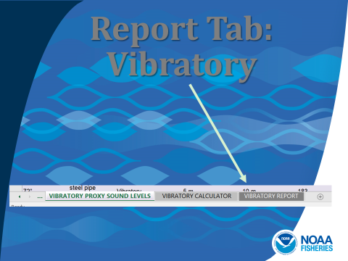
Let’s demonstrate the Vibratory pile driving Report Tab. This Tab can be accessed using the toolbar found at the bottom of the Tool.

Slide 46
The Report Tab summarizes the inputs and outputs provided in the Calculator Tab. The information in this Tab is designed to fit in a single sheet (landscape view). If other information or notes get cut-off from the what was provided in the Calculator Tab, please provide this information elsewhere.

Slide 47
The final slides cover an advanced feature, specifically incorporating weighting based on the pile driving spectrum, if available. This feature is optional.

Slide 48
This Tool automatically provides default weighting for PTS thresholds in the SEL_{cum} metric for both marine mammals and sea turtles. Note auditory weighting functions are not available for fishes. These defaults are illustrated in the yellow boxes and bold red text on this slide and within the Tool on the Calculator Tabs. Note that they are different for marine mammals depending on whether the activity is impact or vibratory pile driving.

Slide 49
This slide simply illustrates that the default weighting is provided in Step 2 of both the Impact (outlined in hot pink) and Vibratory (outlined in turquoise) Calculator tabs.

Slide 50
If a spectrum is available for your particular pile size, material, and location. Default weighting may be adjusted at the bottom of the Calculator Tab, as illustrated by the turquoise box. For pile driving, it is particularly important to pay attention if the spectrum available is for an attenuated or an unattenuated pile and that the available spectrum matches your particular activity. Note, NMFS cautions using spectrum associated with bubble curtains, unless the exact same bubble curtain/settings is proposed for the specific project. The user should also note if a spectrum is being used and the associated details in Step 1.

Slide 51
Spectrum data would be specifically entered in the gray cells, as illustrated by the red arrow. Inputs should always be negative numbers and are based on the difference between the unweighted SEL level and the marine mammal or sea turtle weighting function. For specific instructions on how to override default weighting, please see the Manual for the Optional User Spreadsheet Tool (marine mammals) found at the web site on this slide.

Slide 52
Thanks for viewing this presentation. If you have technical questions or suggestions to improve this Tool, please feel free to contact the person listed on this slide or if you have project-specific questions, please contact your Headquarter or Regional analyst.

