Slide 1
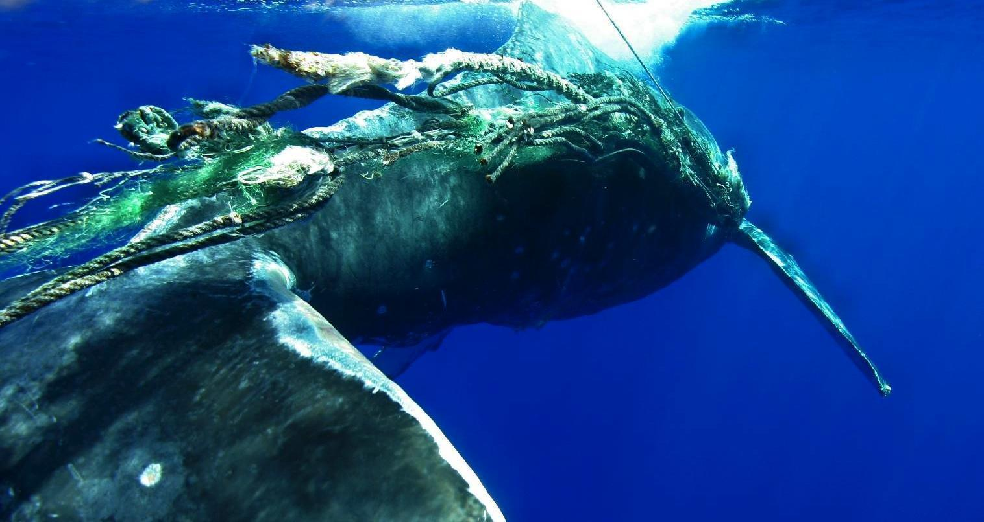

Large Whale Entanglement Response Network Authorization Reviews
NOAA HIHWNMS/MMHSRP (Permit #932-1905)

Slide 2
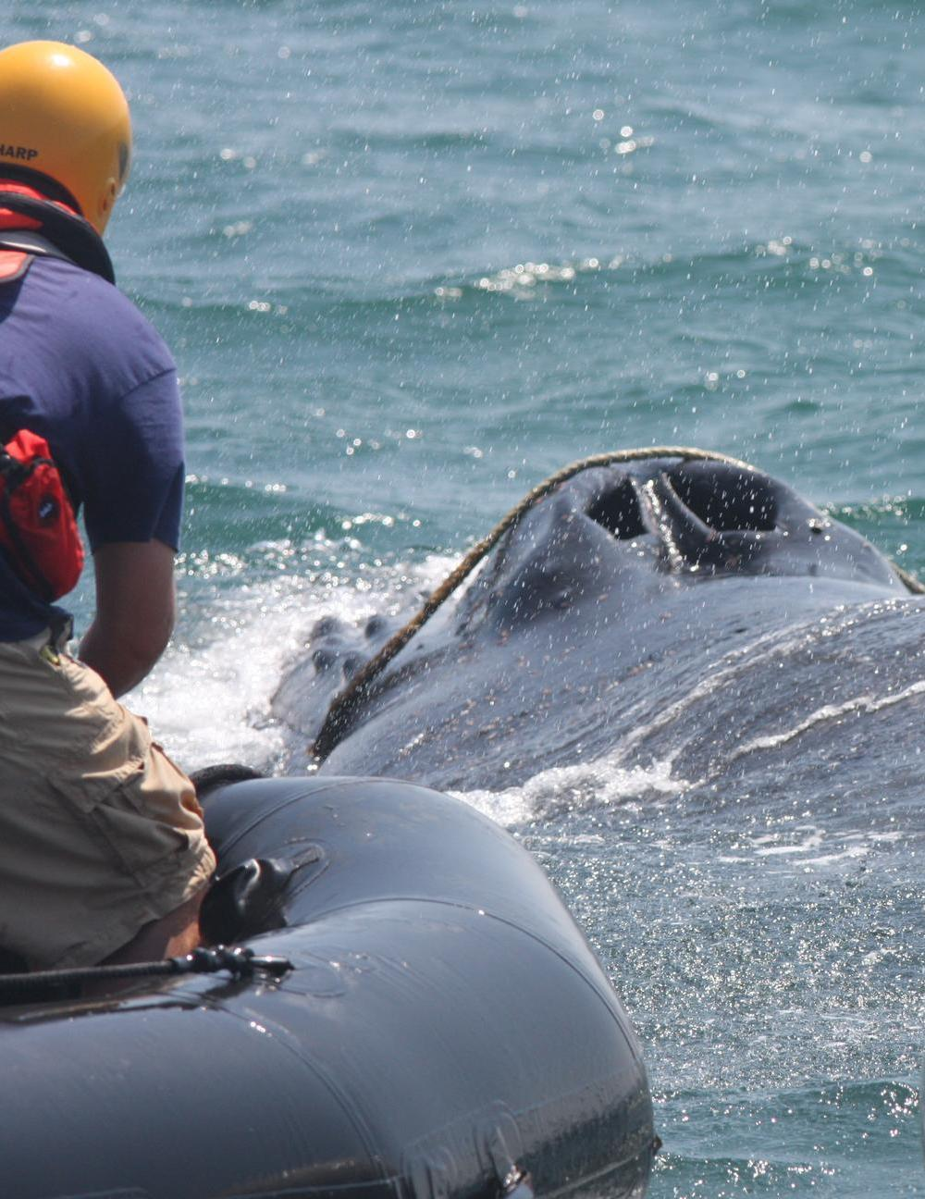
Program Overview
    Program authorized under a MMPA/ESA permit issued to the MMHSRP
    Five Authorization Levels
      First Responders (L1)
      Advanced First Responders (L2)
      Routine Response Coordinators (L3) *
      Advanced Response Coordinators (L4) *
      Right Whale Response Coordinators (L5) *
    Authorization level does not equal importance or value to Network
    *listed as MMHSRP permit co-investigator
      * Authorized as a co-investigator on the MMHSRP permit
PCCS (Permit #932-1905)
NOAA MMHSRP (Permit #932-1905)
Notes:
CI letters are delegating authority and outline activities that can be conducted without prior approval from NOAA. It often takes years to change your permit authority!

Slide 3
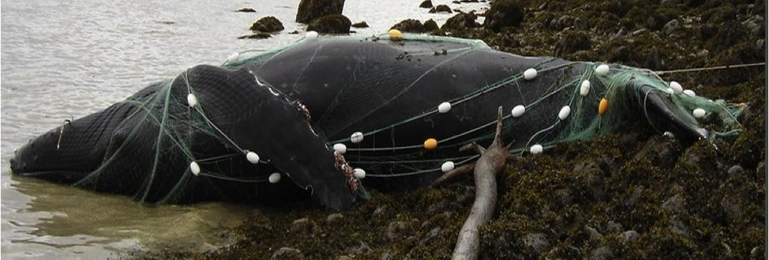
First Responders (Level 1)
Activities:
  Report
  Document/Assess from a safe and legal distance
  Standby/Monitor from a safe and legal distance
Criteria for Authorization
  Online training* or classroom training
  * https://training.whaledisentanglement.org/
NOAA AK PRD/MMHSRP (Permit #932-1905)
Notes:
Eyes on the water. Emphasis is on reporting and standing by until other Network members can arrive on scene

Slide 4
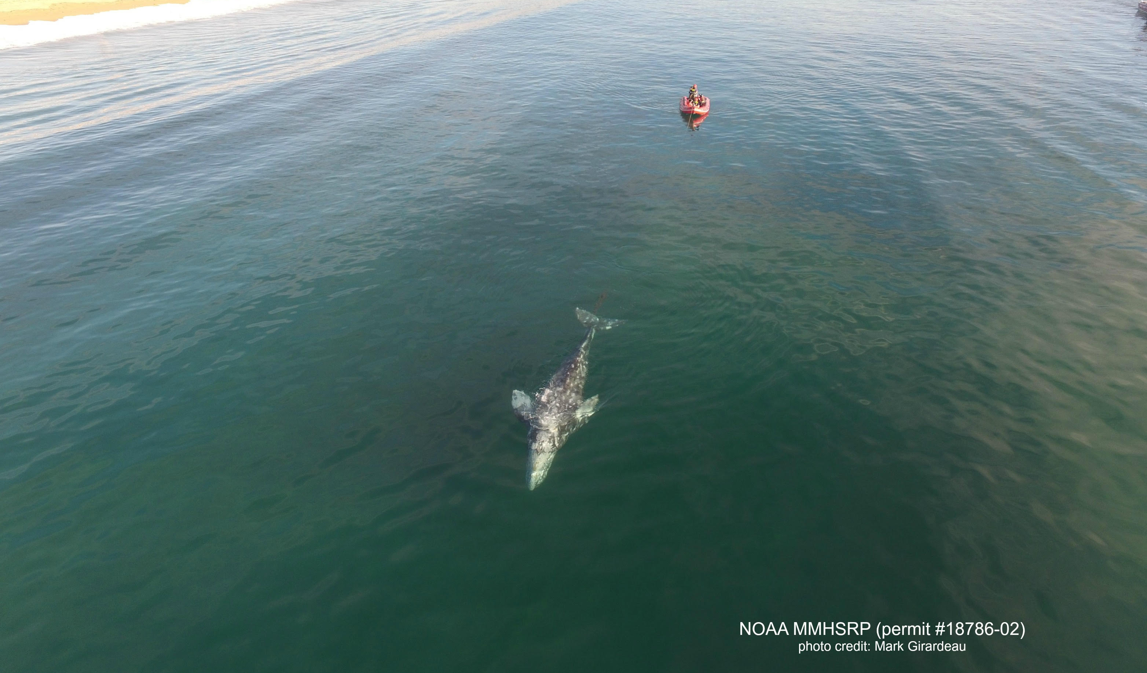
Advanced First Responders (Level 2)
Activities:
  Report
  Document/Assess (can be verbally authorized for close approach)
  Standby/Monitor from a safe and legal distance
  Assist other Network members with response
Criteria for Authorization
  Classroom training
  On-water training
NOAA MMHSRP (Permit #932-1905)
Notes:
Also eyes on the water. Emphasis is more on being able to more effectively document. Level 2s can be verbally authorized to conduct other activities under the supervision of a permit CI

Slide 5
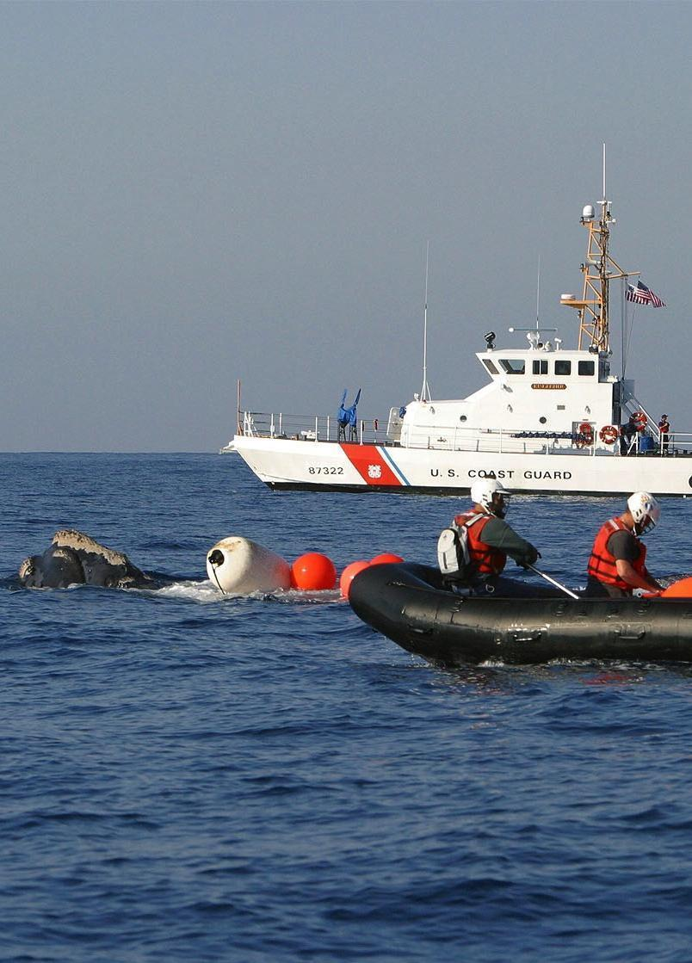
Routine Response Coordinators (Level 3)
Activities:
  Have prior approval to: grapple gear, attach buoys (polyballs) and telemetry to gear/debris
  Coordinate/lead less complex responses
  May be verbally authorized to remove gear/debris by Regional Coordinator
Criteria for Authorization
  Several on-water trainings
  Advanced on-water training (e.g. apprenticeship)
  At least 1 on-water response in which they performed these duties under supervision
NOAA MMHSRP (Permit #932-1905)
Notes:
Listed as a CI under MMHSRP permit, and we are delegating some authority to the leaders of responses.
Some regions may waive specific activities if they are not conducted routinely (e.g. attaching satellite tags is not done routinely in some areas of the country, so we would look to see that a candidate has grappled gear, responded to anchored whales, etc. – events that are typical for that particular region)

Slide 6
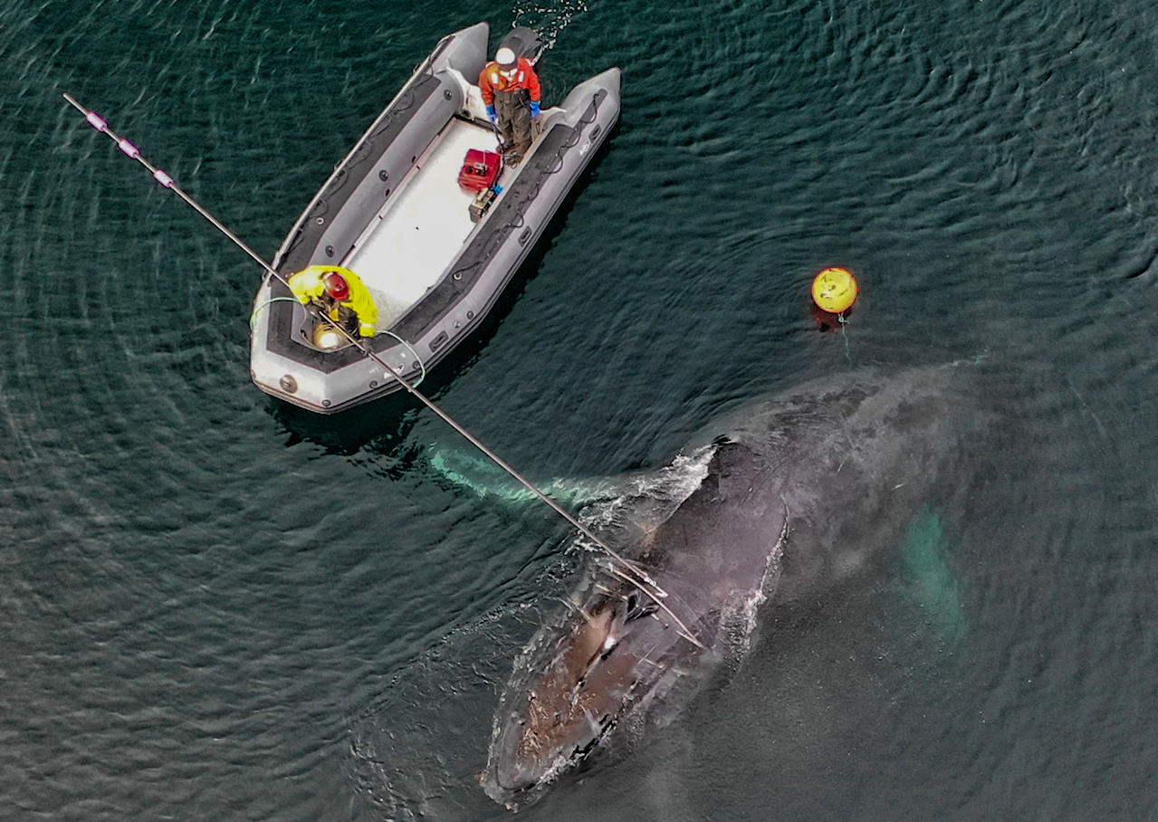
Advanced Response Coordinators (Level 4)
Activities:
  Have prior approval to: grapple gear, attach buoys and tags to gear/debris, remove gear/debris (excluding right whales)
  Coordinate/lead complex responses
Criteria for Authorization
  Numerous on-water trainings (less important than responses)
  Multiple on-water responses in which they performed all of these duties under supervision
  Assessment by mentor/Network peers
PCCS (Permit #932-1905)
Notes:
There is a big gap between 3 and 4. We are looking for many responses over a long time period so that we know you have been exposed to a variety of situations and operated under varying circumstances. However, the main difference is where the authorization comes during the response- a Level 3 can receive verbal authorization from a Regional Coordinator while a Level 4 is pre-authorized to conduct the response in full but must debrief with the Regional Coordinator when they are able. We are looking for folks that have done multiple aspects/roles in a response multiple times.

Slide 7
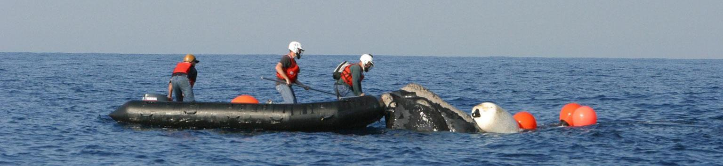
Right Whale Response Coordinators (Level 5)
Activities:
  Can conduct the same activities as Advanced Response Coordinators (Level 4), including on right whales
Criteria for Authorization
  Numerous on-water trainings
  Advanced on-water training (i.e. apprenticeship)
  Multiple on-water responses in which they performed these duties on right whales under supervision
NOAA MMHSRP (Permit #932-1905)
Notes:
Right whales are more dangerous and therefore require more experience. Similar to 4, we are looking to see that advanced responders have served in multiple roles during different responses so that they can oversee others and ensure things are conducted in a safe manner.

Slide 8
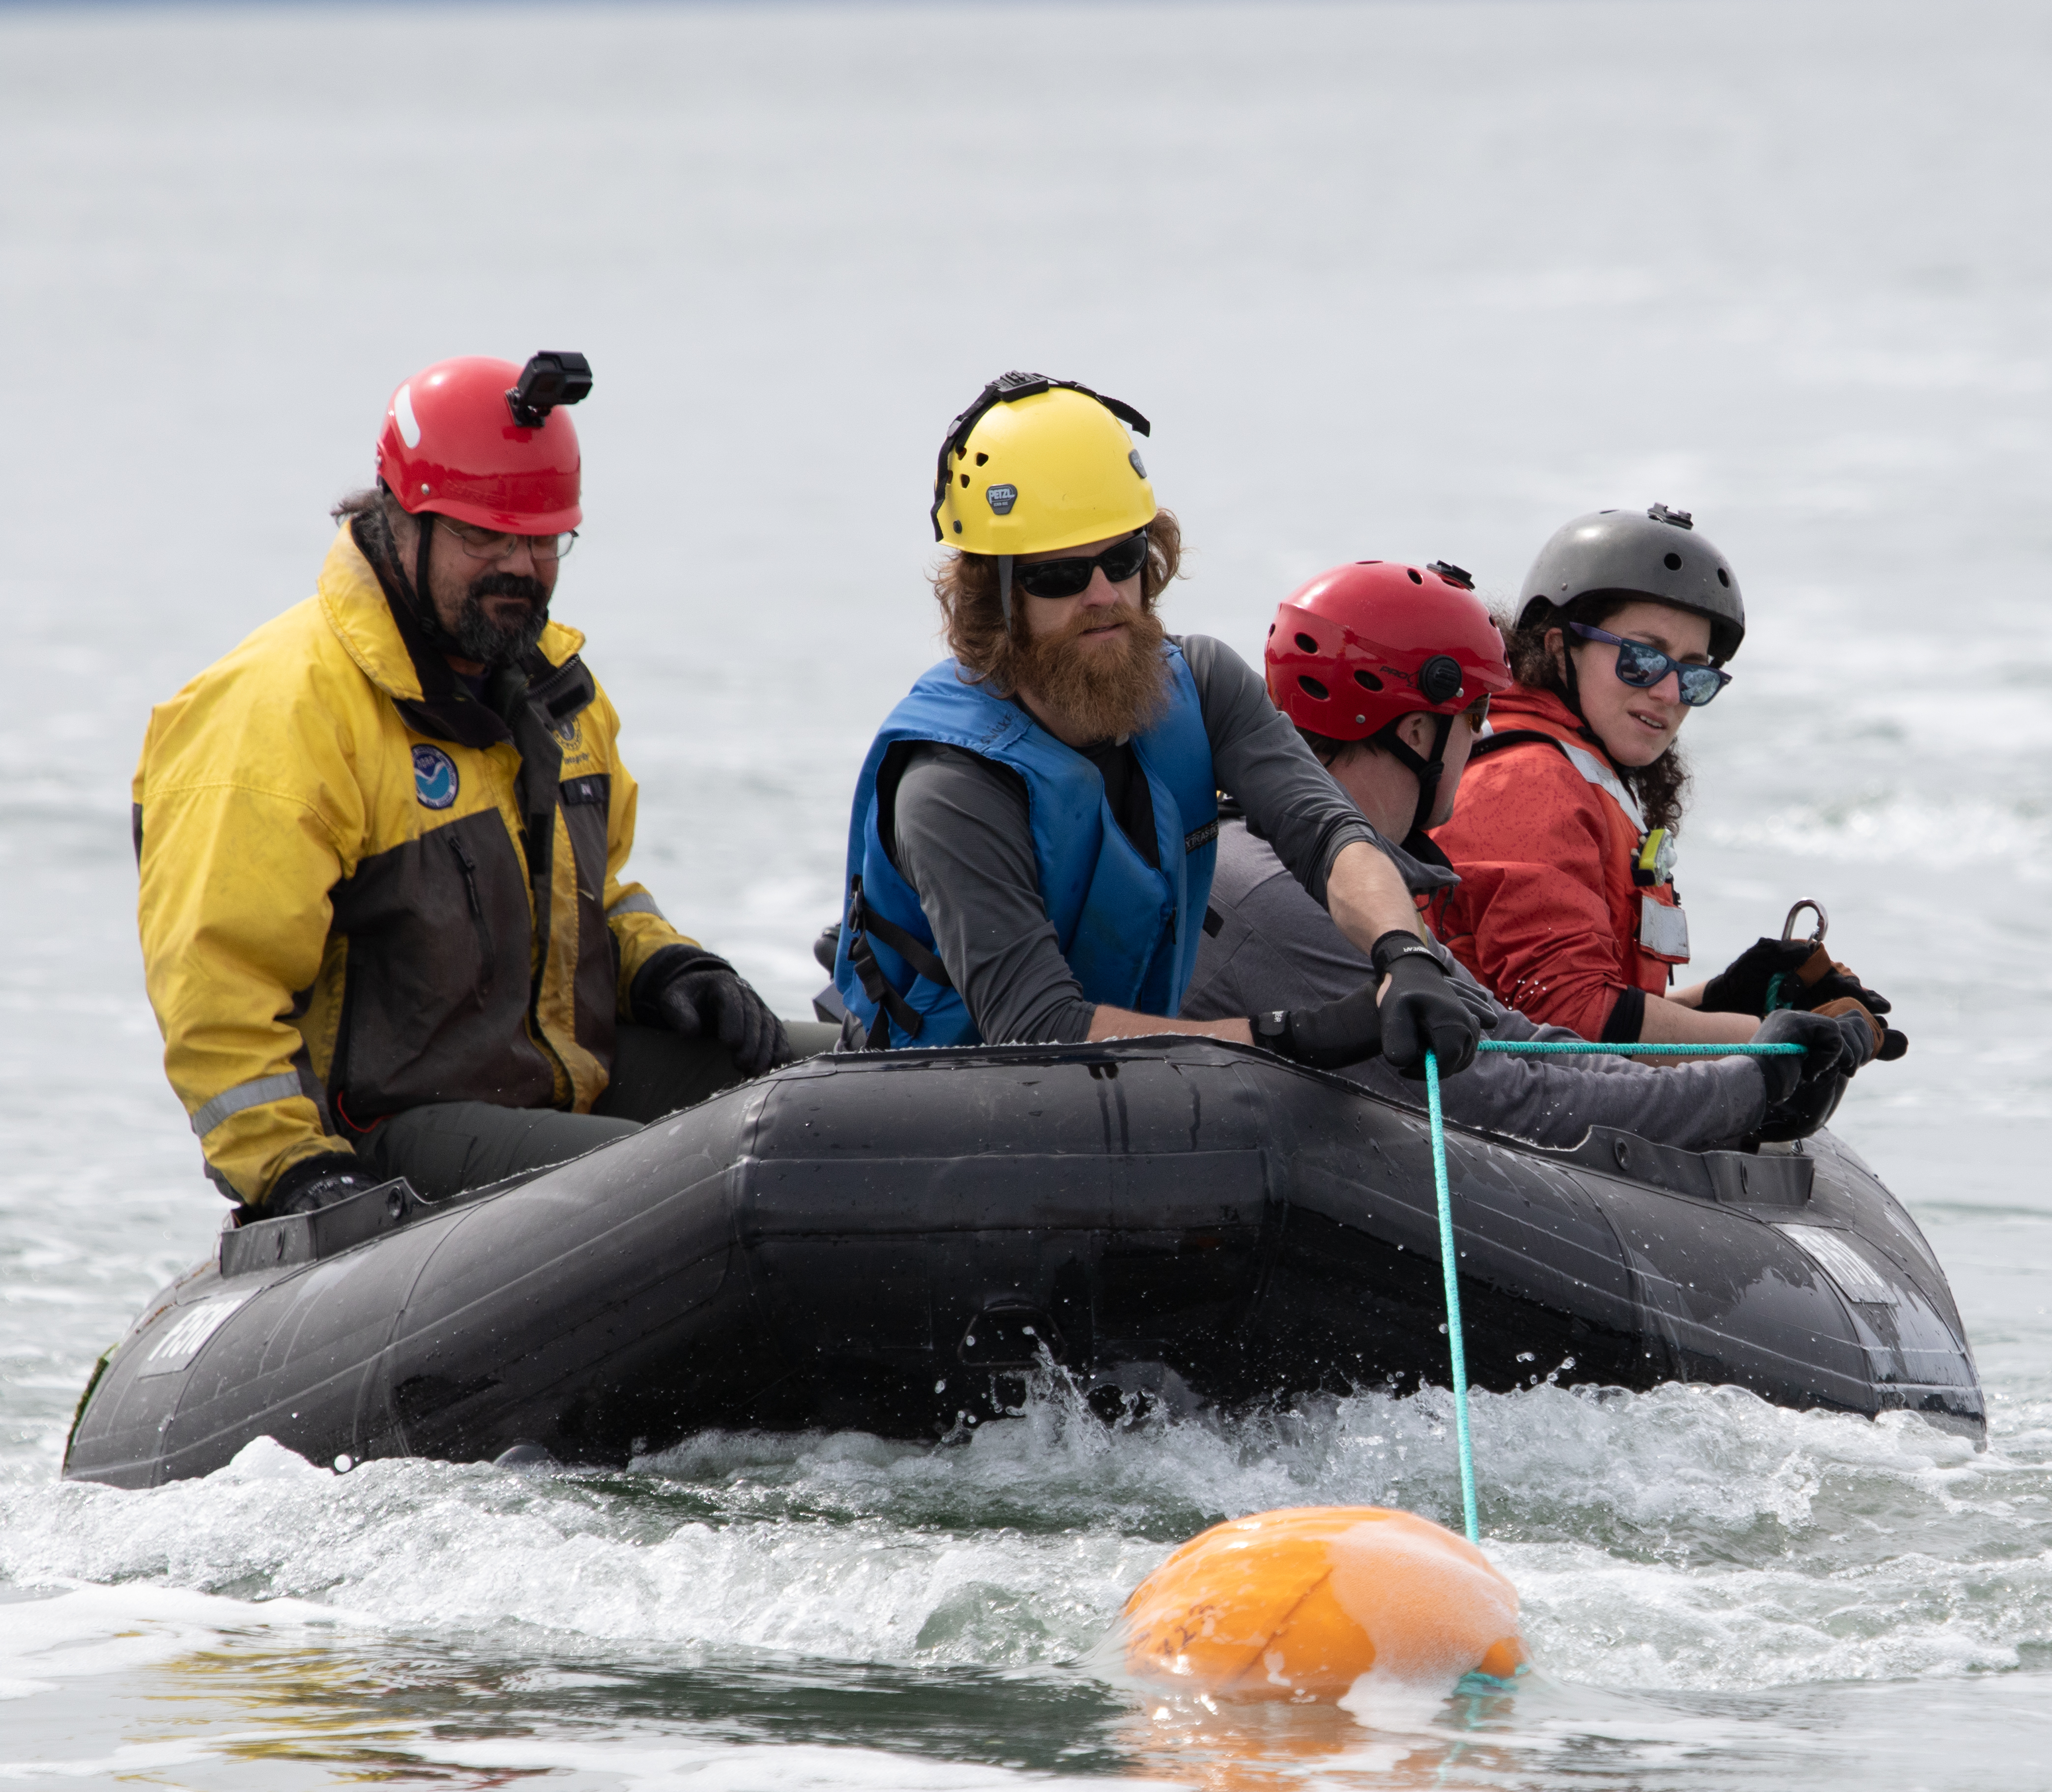
Mentorships
Mentorship/apprenticeship typically needed to acquire the necessary skills during responses
Mentor oversees apprentice’s work
Mentor gives the apprentice opportunities to perform at the next authorization
  Ex. Mentor working with a Lv2 responder oversees their work to attach the tag
Patience is required as it often takes years to conduct enough responses
NOAA AK PRD/MMHSRP (Permit #932-1905)

Slide 9
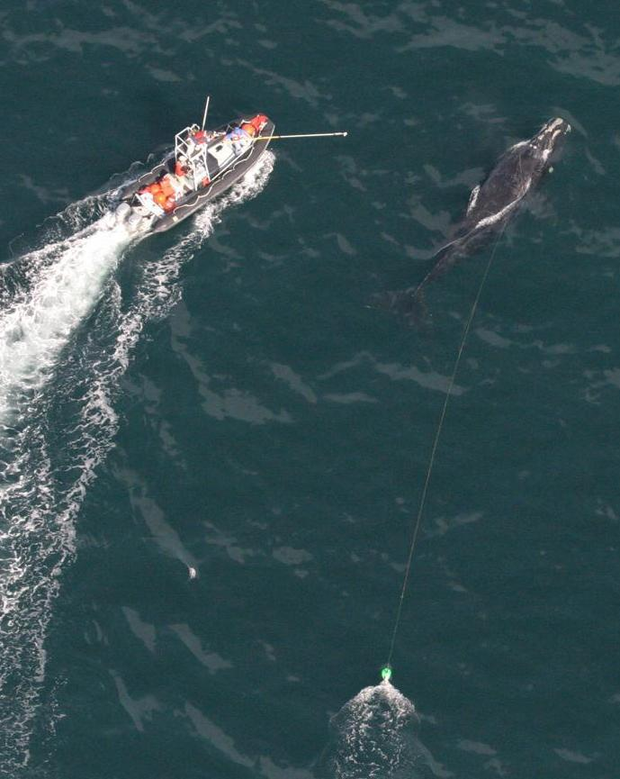
Authorization Reviews
Biannual reviews for people looking to change their authorization (November and April)
HQ staff, regional entanglement coordinators, and mentors
  Your mentor should recommend you for the review
Mentors should be able to speak to most aspects of the applicant’s responses
FL-FWC (Permit #932-1905)
Notes:
Mentor is ideally someone who you usually train/respond with the most (if not always).

Slide 10
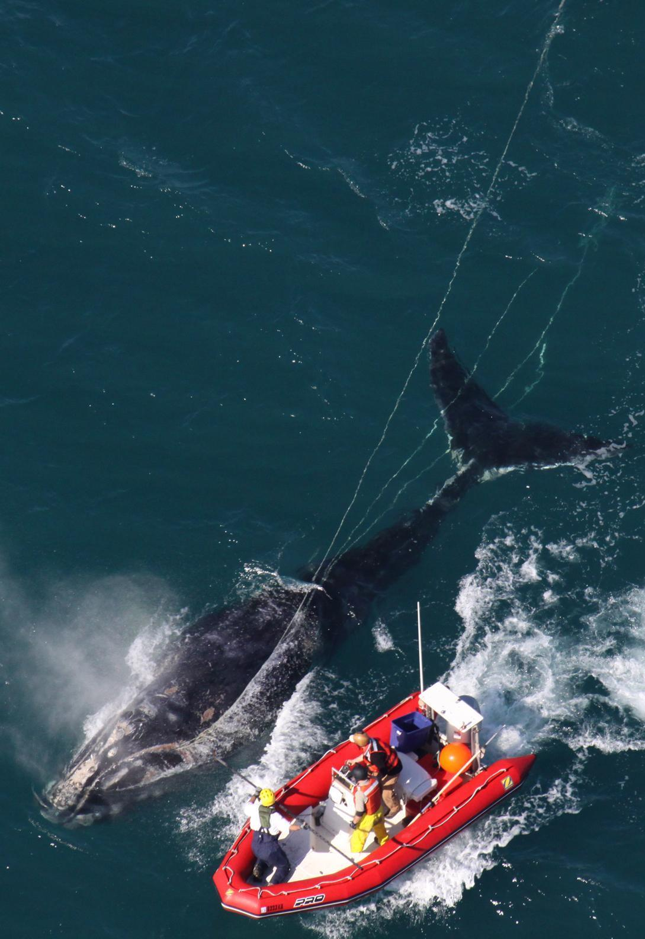
Applications
Applications should include:
  CV (requirement of permit)
  List/spreadsheet of entanglement responses that highlight the roles you performed, especially those at the next authorization type
  Photos/videos highlighting your response efforts (if possible)
We offer constructive feedback to everyone who applies
FL-FWC (Permit #932-1905)
Notes:
So if we decide to not change your authorization, we will give you constructive, specific feedback on what aspects of your application were lacking and how you can improve your expertise in that area.

Slide 11
Example List of Responses
FL-FWC (Permit #932-1905)

Slide 12
What do we look for with Permit CIs?
    Primary goal/objective is safety of the team
    Know when to stand down (temperament)
    Hands-on experience conducting the work they will be coordinating
      Requires CIs to be reasonably fit to conduct the most physically demanding aspects of response
    Leadership, communication, and coordination skills
    Commitment to train others
NOAA MMHSRP (Permit #932-1905)

Slide 13
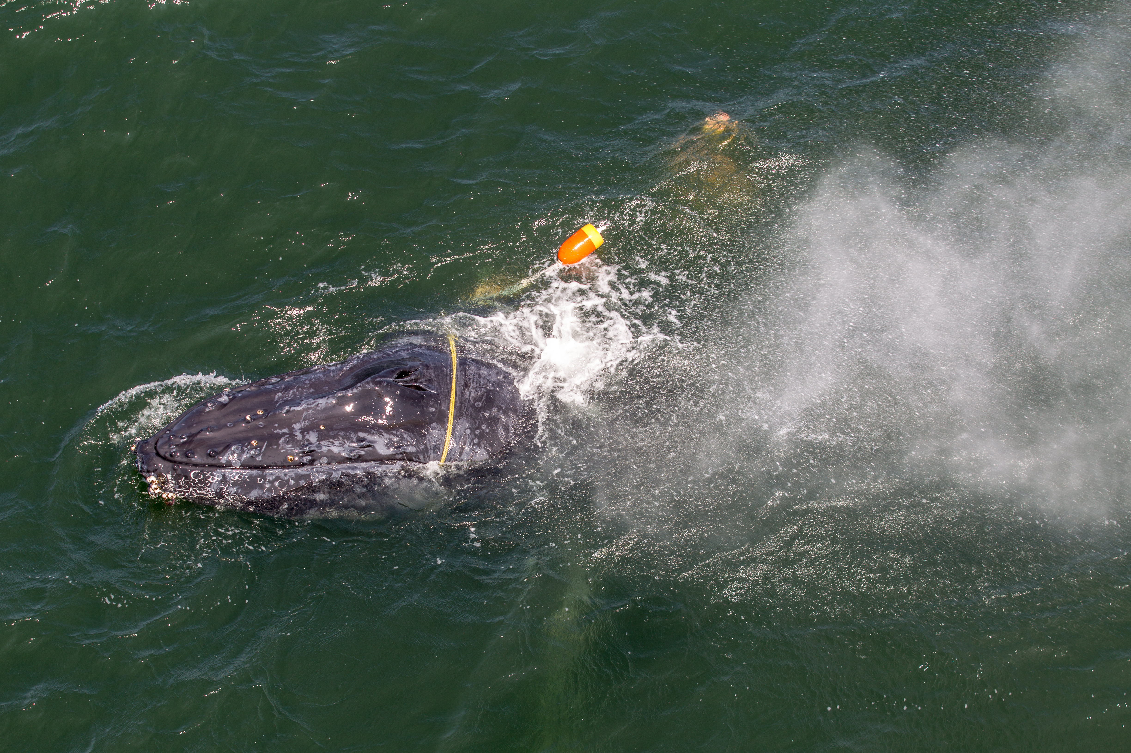
Questions?
NOAA/Wildlife Trust (Permit #932-1905)
Notes:
Please email questions to Stephen.Manley@noaa.gov

